Slide 1
VUV PHOTON SOURCE OF A MICROWAVE EXCITED MICROPLASMAS AT LOW PRESSURE*
Peng Tian^{a)}, Mark Denning^{b)} , Randall Urdhal^{b)}
and Mark J. Kushner^{a)}
^{a)}University of Michigan, Ann Arbor, MI 48109 USA
tianpeng@umich.edu, mjkush@umich.edu
^{b)}Agilent Technologies, 5301 Stevens Creek Blvd, Santa Clara, CA
mark.denning@agilent.com, randall_urdahl@agilent.com
66th Gaseous Electronics Conference 2013, Princeton NJ, USA
* Work supported by Agilent Technologies.

Slide 2
AGENDA
Microplasma UV/VUV photon sources
Split Ring Microwave Micro-plasma
Description of model
Photon generation
  Pressure
  Pd Scaling
  Pulsing with Ar/He gas mixtures
Concluding Remarks
University of Michigan
Institute for Plasma Science & Engr.
GEC_2013 P.T.

Slide 3
UV/VUV PHOTON SOURCES BY MICROPLASMA
Rare gas microplasmas are efficient and discretely tunable UV/VUV light sources.
Compact, inexpensive microplasma light sources have many applications ranging from analytical chemistry, mass spectrometry and surface analysis.
Controlling metastable fluxes, light wavelengths and ion, VUV photon fluxes are important to achieving chemical selectivity.
Microwave excited microplasmas can provide lower excitation voltage, high power efficiency and longer life time of the devices compared with DC microplasmas.
In this project, a microwave excited microplasma light source by a split-ring resonator (SRR) antenna will be studied as discretely tunable VUV source.
University of Michigan
Institute for Plasma Science & Engr.
GEC_2013 P.T.

Slide 4
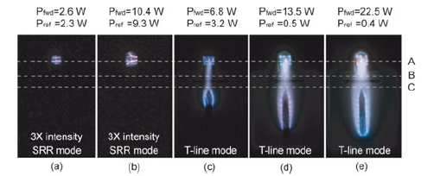
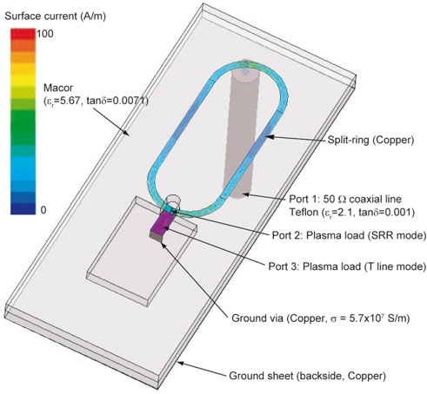
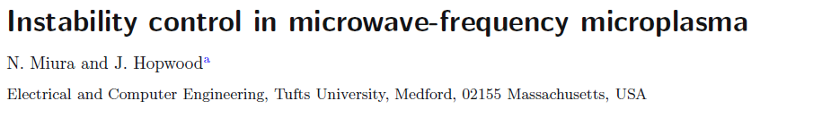

SPLIT-RING-RESONATOR (SRR) MICROPLASMA
A microstrip split-ring resonator was investigated to ignite and sustain a RF microplasma proposed by N. Miura and J. Hopwood.
This concept was further developed as a SRR microplasma cavity as VUV light source.
University of Michigan
Institute for Plasma Science & Engr.
GEC_2013 P.T.

Slide 5
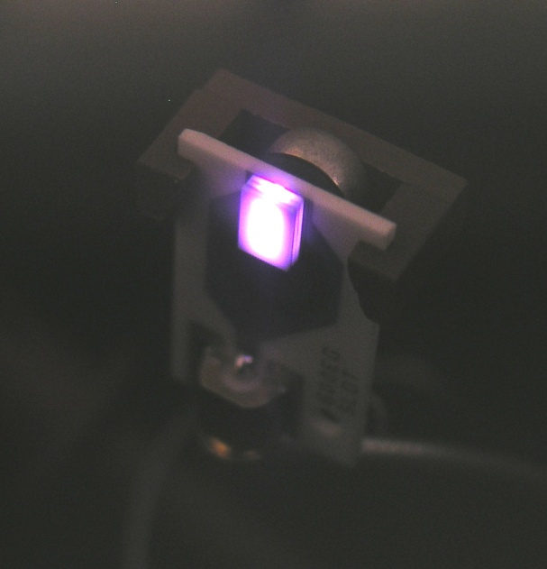
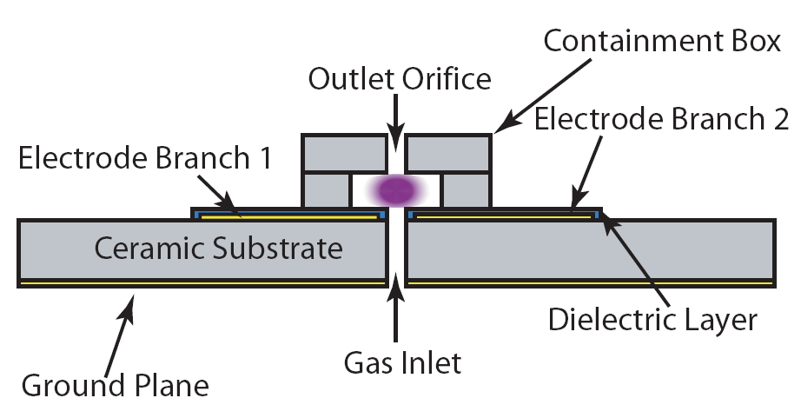
LOW PRESSURE MICROPLASMA CAVITY
Rare gases and rare-gas mixtures with flow rates of 1-10 sccm through a structure ~ 2 mm wide with power of a few watts.
Confined structure enables operation at a few Torr while exhausting into near vacuum.
University of Michigan
Institute for Plasma Science & Engr.
GEC_2013 P.T.

Slide 6
SRR-GEOMETRY BASE CASE
Main focus: production of VUV photons and metastable states at the collection plane.
Microwave capacitively coupled plasma excited by push-pull electrodes.
Quartz coated electrodes.
Base Condition:
  Ar, 4 Torr, 3 sccm
  2.5 GHz CW power, 2 W.
  Cavity width: 2 mm
University of Michigan
Institute for Plasma Science & Engr.
GEC_2013 P.T.

Slide 7
ATOMIC MODEL FOR Ar
Ar⁺
Argon Species:
  Ar(3s), Ar(¹s_{2,3,4,5}),
  Ar(4p), Ar(4d),
  Ar⁺, Ar₂⁺, e
Electron impact excitation and super-elastic collisions between all levels.
Radiation transport for Ar(¹s₂) (106 nm), Ar(¹s₄) (105 nm) and Ar₂* (121 nm).
Ar(4d)
Ar(4p)
Ar(¹s₂)
Ar(¹s₃)
Ar(¹s₄)
Ar(¹s₅)
λ = 105, 106 nm
Ar(3s)
University of Michigan
Institute for Plasma Science & Engr.
GEC_2013 P.T.

Slide 8
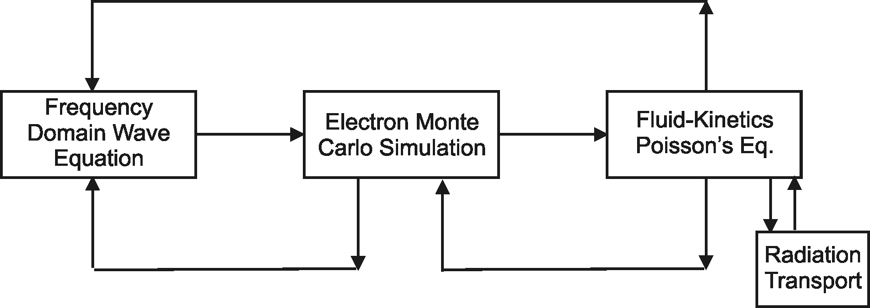
HYBRID PLASMA EQUIPMENT MODEL
Surface
Chemistry
Module
The Hybrid Plasma Equipment Model (HPEM) is a modular simulator that combines fluid and kinetic approaches.
Radiation transport is addressed using a spectrally resolved Monte Carlo simulation.
University of Michigan
Institute for Plasma Science & Engr.
GEC_2013 P.T.

Slide 9
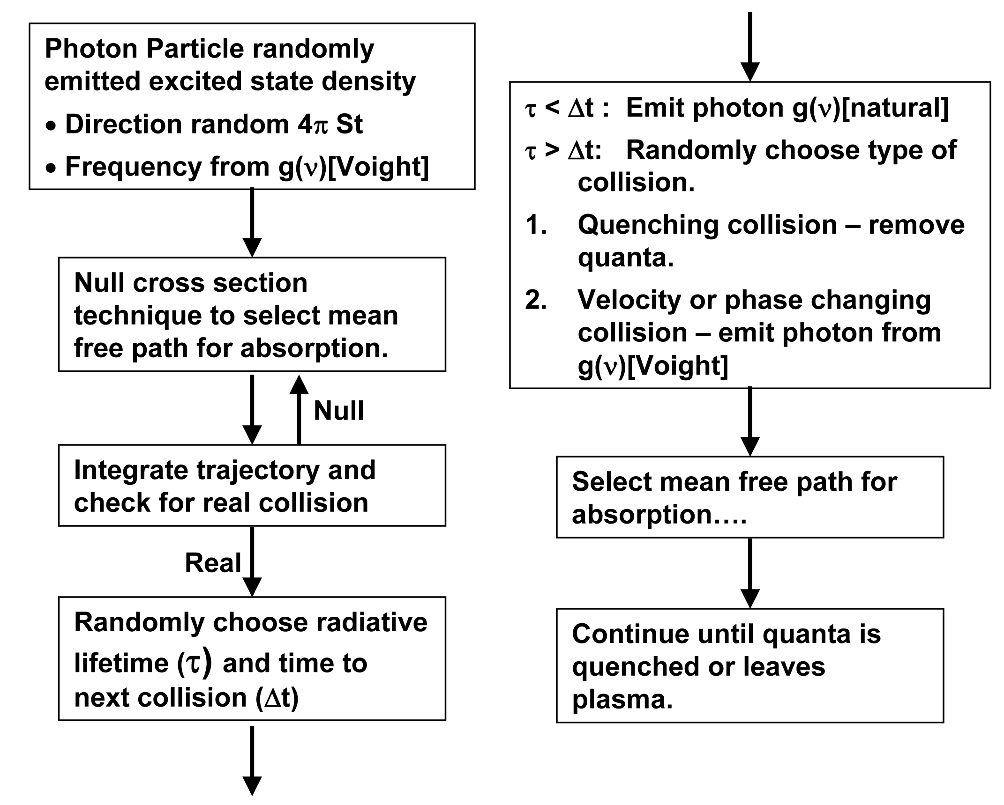
RADIATION TRANSPORT MODEL IN HPEM
Frequency resolved radiation transport in HPEM is modeled using a Monte Carlo simulation that accounts for radiation trapping
GEC_2013 P.T.

Slide 10
ELECTRON DENSITY & TEMPERATURE
Electron Density
Electron Temperature
Electron density reaches nearly 10¹⁴ cm⁻³, or an ionization fraction of 1%.
High energy electrons scatter through nozzle due to smaller collision cross section.
Ar, 4 Torr, 3 sccm, 2 W
University of Michigan
Institute for Plasma Science & Engr.
GEC_2013 P.T.

Slide 11
ION DENSITIES
Ar⁺ Density
Ar₂⁺ Density
Substantial amount of Ar₂⁺ are created by 2 body associative ionization.
Ions driven through nozzle by positive plasma potential.
Ar, 4 Torr, 3 sccm, 2 W
University of Michigan
Institute for Plasma Science & Engr.
GEC_2013 P.T.

Slide 12
FLUX TO TOP PLANES
Ion and Photon fluxes
Total Ion and Photon flux
Resonant radiation from Ar excited states is the main photon source, far exceeding the excimer radiation from Ar₂*.
Ar⁺ and Ar₂⁺ fluxes are comparable at the collection plane.
Ar, 4 Torr, 3 sccm, 2 W
Fluxes
University of Michigan
Institute for Plasma Science & Engr.

Slide 13
POWER/PRESSURE=0.5 W/Torr: ELECTRON DENSITY
Bulk electron densities maintain a diffusive profile due to highly conductive plasma.
Peak electron densities are
10¹³ cm⁻³ with power/pressure=0.5 W/Torr
Electron Density (cm⁻³)
University of Michigan
Institute for Plasma Science & Engr.
GEC_2013 P.T.

Slide 14
POWER/PRESSURE=0.5 W/Torr: Ar(¹s₂)+Ar(¹s₄)
As Pressure increases, mean free path decreases.
The source of photons (Ar(¹s₂, ¹s₄)) is localized above electrodes.
Power efficiency of photon generation decreases.
Ar Radiative States (cm⁻³)
University of Michigan
Institute for Plasma Science & Engr.
GEC_2013 P.T.

Slide 15
PD (PRESSURE x SIZE) SCALING
Varying the size of cavity, while keeping
pd (pressure x size) constant.
The input power is
also varied to keep (power/N_{gas}• Volume) constant.
Flow rate adjusted to maintain constant gas residence time.
1
1/2
1/4
University of Michigan
Institute for Plasma Science & Engr.
GEC_2013 P.T.

Slide 16
PD SCALING : LIGHT SOURCE SIZE
Photon sources are confined at center of the cavity.
Relative source size (Source/Cavity) decreases at higher pressure (i.e., smaller cavity).
4 Torr
Relative Source Size
8 Torr
16 Torr
Ar(¹S₂)+Ar(¹S₄), Max=8.7 x 10¹³ cm⁻³ [2 dec]
University of Michigan
Institute for Plasma Science & Engr.
GEC_2013 P.T.

Slide 17
PD SCALING: EFFICIENCY
As pressure increases (cavity size decreases):
  The photon source is more focused at center of the cavity, providing larger viewing angle to top plane.
  Power efficiency of photon source increases.
Photon Flux vs. Power
Photon Flux
University of Michigan
Institute for Plasma Science & Engr.
GEC_2013 P.T.

Slide 18
PULSING - GAS MIXTURES: Ar
Bulk Ion Density
and Photon Flux
T_{e} and Plasma Potential
Electron temperature over-shoots at the beginning of pulse.
Bulk averaged photon flux and ion density peaked during pulse-on time.
200 kHz PRF, 10% DC, 160 V.
University of Michigan
Institute for Plasma Science & Engr.
GEC_2013 P.T.

Slide 19
PULSING - GAS MIXTURES: He/Ar
He/Ar=10/90
He/Ar=70/30
He/Ar=90/10
With more He, larger over-shoot of T_{e} enhanced photon generation during pulse-on period.
University of Michigan
Institute for Plasma Science & Engr.
GEC_2013 P.T.

Slide 20
PULSING - GAS MIXTURES: He/Ar
He/Ar=10/90
He/Ar=70/30
He/Ar=90/10
Penning ionization is depleting He radiative states during afterglow.
Ar⁺ is always the dominant ion in plasma.
University of Michigan
Institute for Plasma Science & Engr.
GEC_2013 P.T.

Slide 21
CONCLUDING REMARKS
Modeling of a microwave excited SRR microplasmas as sources of VUV light.
Pure Ar plasma at 4 Torr, 2 W produces peak electron density close to 10¹⁴ cm⁻³, a fractional ionization of 1%.
Shape and position of light source in plasma can be controlled by pressure.
The relative size of light source in plasma and power efficiency of photon flux generation is related to the size of the cavity, with p*d scale kept unchanged.
Pulsing with He addition could increase T_{e} and thus enhanced pulsing effect.
University of Michigan
Institute for Plasma Science & Engr.
GEC_2013 P.T.
Notes:
21
21

Slide 22
BACKUP SLIDES

Slide 23
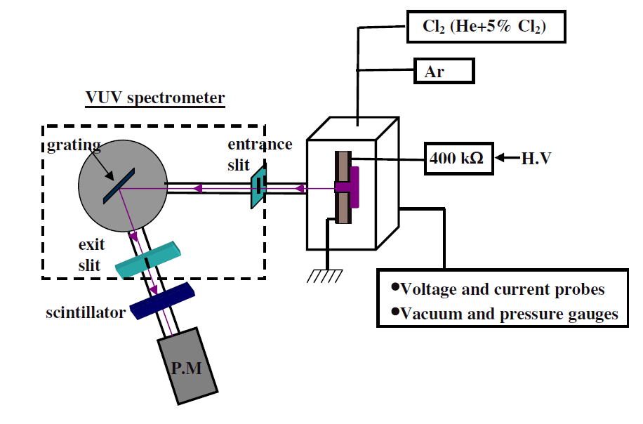
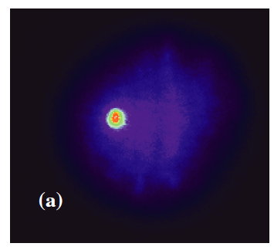
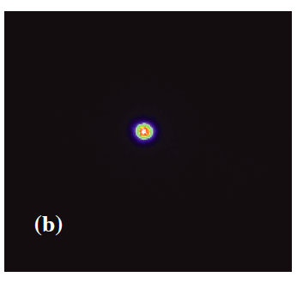
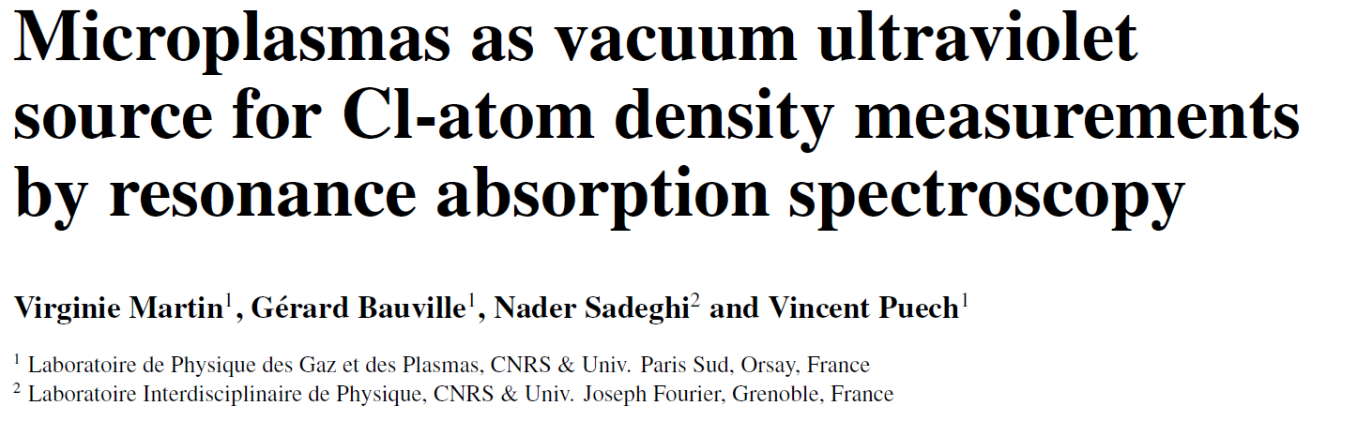
APPLICATION OF MICROWAVE LIGHT SOURCES
Microplasmas as VUV light source for resonance absorption spectroscopy
University of Michigan
Institute for Plasma Science & Engr.
GEC_2013 P.T.

Slide 24
HPEM-EQUATIONS SOLVED -
Electron Energy Distributions – Electron Monte Carlo Simulation
Phase dependent electrostatic fields
Phase dependent electromagnetic fields
Electron-electron collisions using particle-mesh algorithm
Phase resolved electron currents computed for wave equation solution.
Captures long-mean-free path and anomalous behavior.
Separate calculations for bulk and beam (secondary electrons)

Slide 25
HPEM-EQUATIONS SOLVED -

Slide 26
VARYING PRESSURE AND POWER: CONDITION
Pressure (Torr) | Power (W)
4 | 2
6 | 3
8 | 4
10 | 5
12 | 6
16 | 8
20 | 10
Based on base case condition, change pressure and power.
Power deposited per particle is kept constant by keeping Power/Pressure = 0.5 W/Torr
GEC_2013 P.T.

Slide 27
PULSED PLASMAS
Carrier frequency is modulated by a pulse, a fixed pulsing voltage and duty cycle.
The fast rising edge can “over-shoot” the self sustaining E/N, raising the “hot tail” in EEDF f(ε).
P_{max}
Power(t)
Duty Cycle
P_{min}
Time
τ = 1/υ
University of Michigan
Institute for Plasma Science & Engr.
GEC_2013 P.T.

