Slide 1
A STATISTICAL PHOTON TRANSPORT MODEL: APPLICATION TO STREAMER DISCHARGES IN DRY AIR *
Zhongmin Xiong and Mark J. Kushner
University of Michigan
Department of Electrical Engineering and Computer Sciences
Ann Arbor, MI 48109
zxiong@umich.edu, mjkush@umich.edu
66th Gaseous Electronics Conference 2013, Princeton, New Jersey, USA
* Work supported by the DOE Office of Fusion Energy Science and National Science Foundation

Slide 2
AGENDA
Photon transport in plasma discharge ⎯ nonlocal and ubiquitous.
Streamer branching at atmospheric pressure, its mechanisms and possible connection with photon transport.
Review of current photon transport models in fluid simulations.
A statistical photon transport model.
Application of the statistical model to positive streamer branching.
Concluding remarks
University of Michigan
Institute for Plasma Science & Engr.
GEC2013

Slide 3

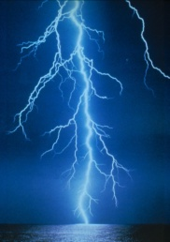
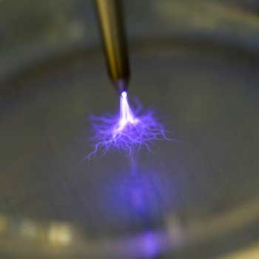
PHOTON TRANSPORT IN PLASMAS
Photon transport is a non-local process and an essential part of plasmas.
Visibility or glow of plasmas, neon sign, lightning, lamps … (scienceblogs.com)
Plasma jets, propagation of plasma bullets. Photo-ionization provides seeding electrons in the non-ionized region (Laroussi et al. IEEE TPS, 36, 1298, (2008))
Synergetic effects of photon fluxes with ion/electron fluxes prompting chemical reactions, e.g. Plasma activated water (Taylor et al, J. PhD. 44, 472001 (2011))
I recommend deleting this slide and replacing with a slide later on that describes the branching mechanisms
Photon transport and photoionization is one of the least understood processes in low temperature plasmas, often replaced with preionization.
University of Michigan
Institute for Plasma Science & Engr.
GEC2013

Slide 4
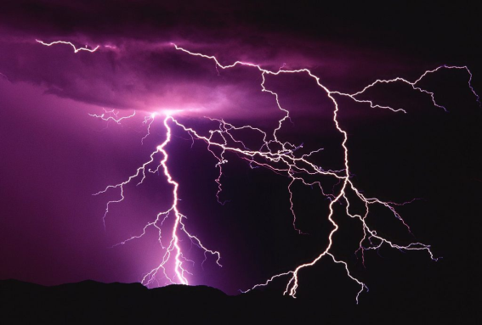
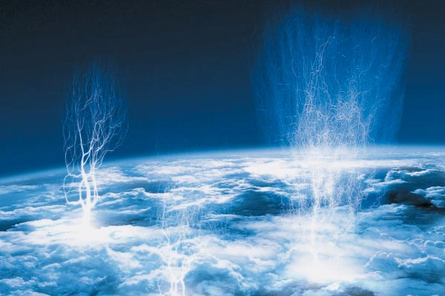
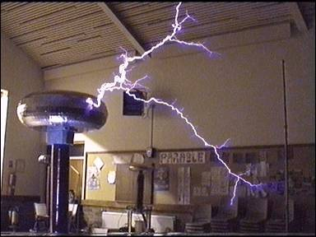
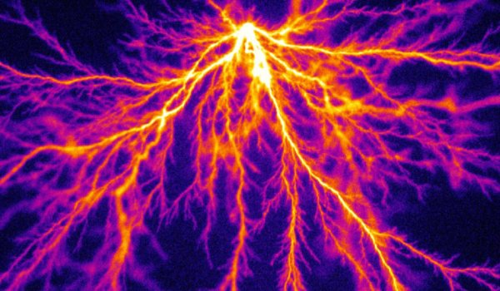
BRANCHING OF STREAMER DISCHARGE
Branching or filamentation appears to be an universal phenomenon in streamer discharges at high pressures.
Naturally occurring lightening branches (below and above the clouds)
Streamer branching
in lab experiments.
(www.jpole-antenna.com) (www.survinat.com)
(www.tcbouk.org.uk)
Nijdam et al, J.Phy D, 43, (2010)
University of Michigan
Institute for Plasma Science & Engr.
GEC2013

Slide 5
MECHANISMS OF STREAMER BRANCHING
Current understanding of spontaneous streamer branching:
  Recent review papers on the physics and modeling
    Ebert et al, PSST, 15 S118 (2006), Nonlinearity, 24 (2011)
    Luque and Ebert, J. Comput. Phys. 231, 904 (2012)
  Stability and fingering of negative planar ionization front (Arrayàs et al. SIAM J. Appl. Math, 2007 )
  3D particle, fluid and hybrid simulations of negative streamers. Effects of electron transport (Li et al, PSST, (2012))
Extensive studies on the branching of negative streamers however less is known about positive streamers where photon-ionization is important. (e.g. Luque at al, PRE, 84 (2011))
In fluid simulations, with a deterministic photon transport model, photo-ionization typically provides a stabilizing effect (for either polarities).
A statistical model for photon transport could be destablizing (Raether, 1939, Loeb& Meek, 1941).
University of Michigan
Institute for Plasma Science & Engr.
GEC2013

Slide 6
MECHANISMS OF STREAMER BRANCHING
Current understanding of spontaneous streamer branching:
  Recent review papers on the physics and modeling
    Ebert et al, PSST, 15 S118 (2006), Nonlinearity, 24 (2011)
    Luque and Ebert, J. Comput. Phys. 231, 904 (2012)
  Stability and fingering of negative planar ionization front (Arrayàs et al. SIAM J. Appl. Math, 2007 )
  3D particle, fluid and hybrid simulations of negative streamers. Effects of electron transport (Li et al, PSST, (2012))
Extensive studies on the branching of negative streamers however less is known about positive streamers where photon-ionization is important. (e.g. Luque at al, PRE, 84 (2011))
In fluid simulations, with a deterministic photon transport model, photo-ionization typically provides a stabilizing effect (for either polarities).
A statistical model for photon transport could be destablizing (Raether, 1939, Loeb& Meek, 1941).
Add a slide that summarizes the branching mechanisms – maybe combine with previous slide.
University of Michigan
Institute for Plasma Science & Engr.
GEC2013

Slide 7
MODELING PLATFORM: nonPDPSIM
Poisson’s equation:
Transport of charged and neutral species:
Surface charge:
Electron temperature:
Radiation transport and photoionization:
University of Michigan
Institute for Plasma Science & Engr.
GEC2012
Notes:
7
7

Slide 8
EXISTING PHOTON-TRANSPORT MODEL
Based on Green’s Function (accounts to absorption, blockage).
At each emitting point, photon fluxes are emitted uniformly in all directions.
Photon fluxes are absorbed continuously at all points along propagation path.
Inside plasmas, most points are both emitting and absorption points.
r’
Abs./Bloc
r
r’
University of Michigan
Institute for Plasma Science & Engr.
GEC2013

Slide 9
STATISTICAL PHOTON-TRANSPORT MODEL
Instantaneous photon flux is emitted in random angles/directions.
Absorption occurs at random distance with probability p(r)=(1/λ) exp(-r/λ), r: distance to the emitting point, λ: photon mean free path
Emission and absorption follows Green’s function only statistically.
Emission
Absorption Sector
(random angle/radius)
r’
For each emitting point, divide its photon transport zone into a number of sectors
Emitting angle and the absorption sector change randomly at each time step.
All points are independent.
r
r’
University of Michigan
Institute for Plasma Science & Engr.
GEC2013

Slide 10
IMPLEMENTATION OF THE STATISTICAL MODEL
Divide photon transport zone at each emitting point by a number of, say 10x10, sectors. Assign each points inside the zone a pair of coordinates (i_sect, j_dist) (Computed only once).
At each time step, pick a random emitting direction, k_sect, then a random absorption distance, k_dist (based on absorption probability)
Compute the total number of photons emitted from this point.
Only points with i_sect=k_sect, j_dist=k_dist receive (all) the photons.
Repeat the above at next time step.
4
Example : Photons emitted with k_sect=3, k_dist = 5.
Points in sector (3,5) absorb the emitted photons.
Non-local process⎯ e.g. no absorption occurs in the nearest sector (3,4) at this point.
6
3
7
3
4
5
2
8
1
9
10
e.g. k_sect = 3, k_dist = 5
University of Michigan
Institute for Plasma Science & Engr.
GEC2013

Slide 11
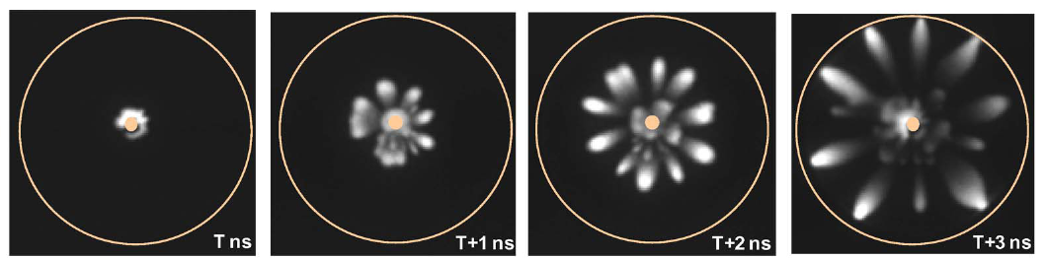
CO-AXIAL DISCHARGE IN DRY AIR
Co-axial corona discharge in dry air (N₂:O₂=4:1, 760 Torr).
Powered electrode: r = 1 mm
Grounded electrode: r = 10 mm
50 kV, 10 ns pulse, with 1 ns rise/fall time.
Chemistry: 19 species, ≈ 150 reactions.
Initial [e]=0 except near the center with [e] = 10⁶ cm⁻³
Photo emitting species: N₂** (b’ ¹Σ⁺_{u}), Birge-Hopfield system ( ≈ 100 nm wavelength, 12 eV)
Photoionization species O₂: absorption cross section σ_{p}= 1 x 10⁻¹⁸ cm²
Have a separate slide that discusses the Wang results
Wang. et al. IEEE TPS. vol.39, 2268 (2011)
University of Michigan
Institute for Plasma Science & Engr.
GEC2013

Slide 12
STABILITY OF IONIZATION FRONTS
Stage I: Initial cylindrical ionization front (IF), near the powered electrode
Stage II: Distorted IF* due to linear instability from infinitesimal disturbances (non-statistical).
Stage III: Breakaway streamers, (probably) linearly stable due to the curved, arrow-head shape.
Focus on (multiple) streamers in stage III, may be nonlinearly unstable, i.e. branching under disturbances of finite amplitudes (statistical).
Stage III
Stage II
Stage I
* Distorted IF: fast part meets a higher E-field (closer to ground) and becomes faster
*Ref. SIAM J. APPL. MATH, 2007 (for negative IF only)
IF
University of Michigan
Institute for Plasma Science & Engr.
GEC2013

Slide 13
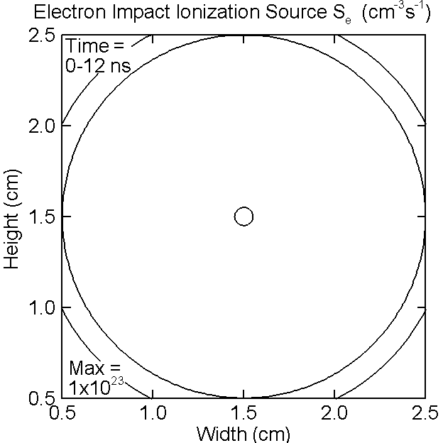
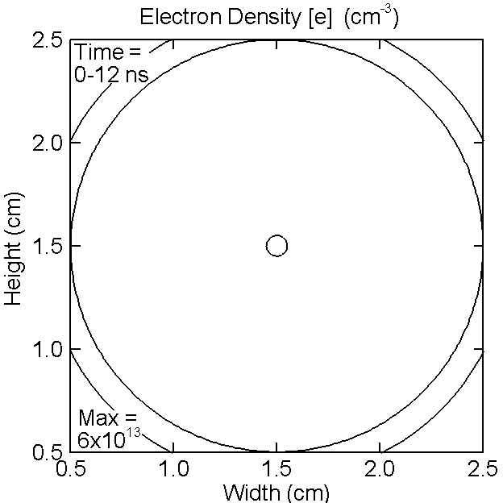
EXISTING MODEL ⎯ S_{e} AND [e]
Initial circular IF breaks into multi-streamers; speed ≈ 5x10⁷ cms⁻¹; S_{e} vanishes as the voltage at the power electrode turns off.
Log. scale, 4 dec.
University of Michigan
Institute for Plasma Science & Engr.
Animation Slide
GEC2013

Slide 14
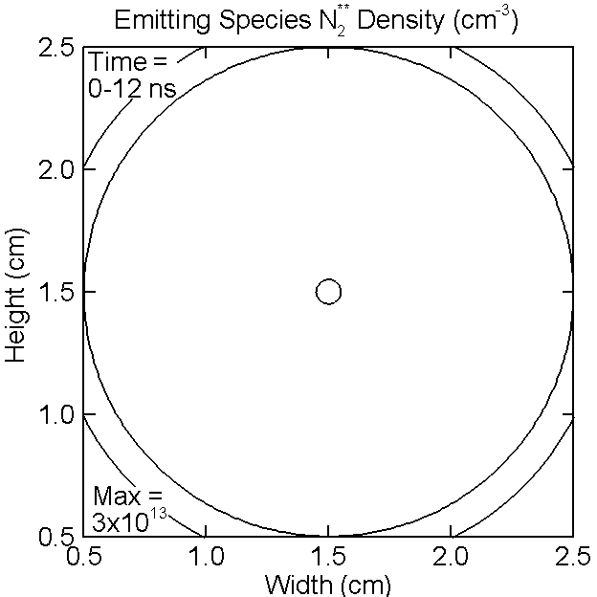
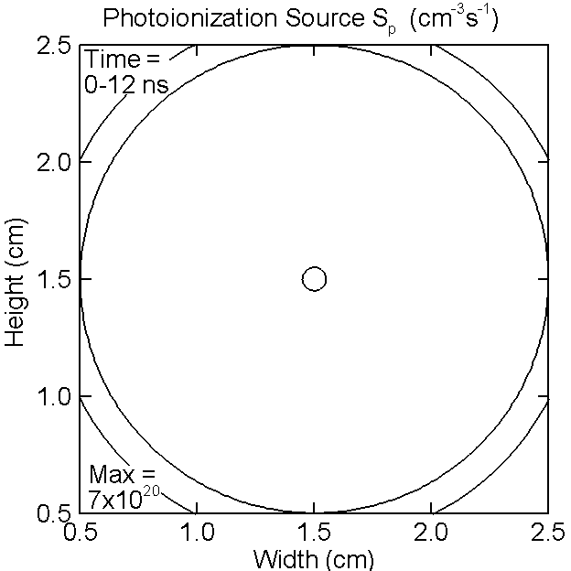
EXISTING MODEL ⎯ [N₂**] AND S_{p}
Initially similar to [e], [N₂**] has finite life-time and later peaks at the streamer heads. Photoionization source S_{p}, locally smooth, all directions
Log. scale, 4 dec.
University of Michigan
Institute for Plasma Science & Engr.
Animation Slide
GEC2013

Slide 15


STATISTICAL MODEL ⎯ S_{e} AND [e]
Statistically similar process of streamer formation; speed ≈ 6x10⁷ cms⁻¹ .
Streamers jitter and change directions, bottom one branches at the end.
Log. scale, 4 dec.
University of Michigan
Institute for Plasma Science & Engr.
Animation Slide
GEC2013

Slide 16

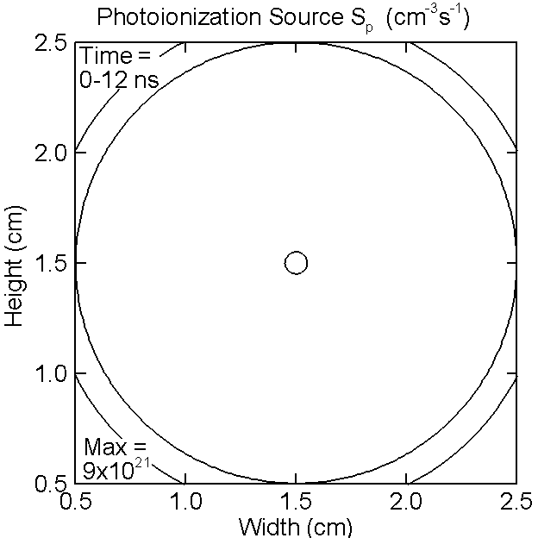
STATISTICAL MODEL ⎯ [N₂**] AND S_{p}
[N₂**] has finite life-time and peaks at the streamer heads. Photoionization source S_{p}, instantaneous random field, follow Green’s function statistically
Log. scale, 4 dec.
University of Michigan
Institute for Plasma Science & Engr.
Animation Slide
GEC2013

Slide 17
MODEL COMPARISONS ⎯ BRANCHING PROCESS
In deterministic model, photoionization tends to smooth the E-Field.
In the statistical model, the instantaneous photoionization rate can be an order of magnitude higher than in the deterministic model.
The large, statistical fluctuations in photo-electron production promote nonlinear instability, i.e. streamer branching.
Streamer branching occurs only sometimes.
Existing
Not
branching
Statistical
Branching
Log. scale, 4 dec.
University of Michigan
Institute for Plasma Science & Engr.
GEC2013

Slide 18
ROBUSTNESS STREAMER BRANCHING
Streamer branching with varying initial [e], mesh size and statistical options. Base case has 35,000 nodes, mesh spacing XX cm.
What is the mesh size?
Base case mesh, slightly off-center initial [e],
Halve mesh spacing (70,000 nodes), on-center initial [e]
Halve mesh spacing (70,000 nodes), double number of sectors
Streamer branching mechanism due to statistical photon transport appears to be reasonably robust.
University of Michigan
Institute for Plasma Science & Engr.
GEC2013

Slide 19
CONCLUDING REMARKS
Photon transport is a nonlocal, ubiquitous process in plasma which often plays a critical role in determining discharge physics.
Photon transport in typical fluid simulations is deterministic which tends to smooth the E-field, and likely underestimate photonionization near the critical point of discharge development, such as streamer branching.
A statitical photon transport model is proposed based on randomized emitting angle and absorption distance (probability-weighted).
The statistical photon transport model was used to simulate atmospheric pressure streamer discharge and compared with the deterministic model.
It is shown that the branching of a positive streamer may be explained as the consequence of the statistical nature of the photon transport at the streamer head.
The statistical photon-induced streamer branching appears to be reasonably robust.
University of Michigan
Institute for Plasma Science & Engr.
GEC2013

Slide 20
APPENDIX
Experiments showing the formation of positive streamers through a destabilized ionization front (at 1/5 atmospheric pressure)
Results from a simplified statistical model, where only the emiting angle is randomized but the aborption along propagation path is continueous.
University of Michigan
Institute for Plasma Science & Engr.
GEC2013

Slide 21
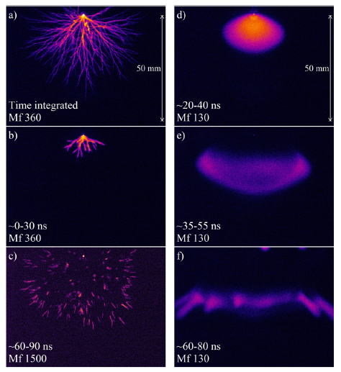
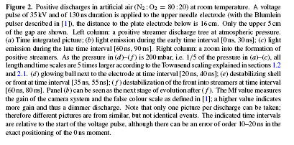
EXPERIMENTS
Formation of positive streamers through a destabilized ionization front (right column), (Ebert. et al, Nonlinearity, 24 C1, 2011)
University of Michigan
Institute for Plasma Science & Engr.
GEC2013

Slide 22
RANDOM EMITTING ANGLE ONLY
Use only random emitting angle but continuous radial absorption
Existing
Statistical
University of Michigan
Institute for Plasma Science & Engr.
GEC2013

