Slide 1
CONSEQUENCES OF E-H TRANSITIONS IN IMPEDANCE MATCHING OF PULSED INDUCTIVELY COUPLED PLASMAS*
Chenhui Qu^{a)}, Steven Lanham^{a)}, Peng Tian^{a)},
Carl Smith^{b)}, Kristopher Ford^{b)}, Joel Brandon^{b)}, Steven Shannon^{b)}, and Mark J. Kushner^{a)}
71st Gaseous Electronics Conference
Portland, Oregon USA
November 2018
* Work supported by the US Dept. of Energy Office of Fusion Energy Science, National Science Foundation, Lam Research and Samsung Electronics
a) University of Michigan
Ann Arbor, MI USA
mjkush@umich.edu
b) North Carolina State University
Raleigh, NC USA
schanno@ncsu.edu
Notes:
1
1

Slide 2
AGENDA
Impedance matching in ICPs
E-H Transition
Description of Model
CW: E-H transition
Perfect matching
Choosing a match point
Experiment: Match point during pulse
Duty cycle and IEDs
Concluding Remarks
University of Michigan
Institute for Plasma Science & Engr.
GEC_2018
Notes:
Application for atm discharges

Slide 3
POWER INTO ICP: LOAD ON TRANSMISSION LINE
Inductively coupled plasmas (ICPs) are typically sustained by power from an RF generator through a cable transmission line (TL) – the plasma is the load at the end of the TL.
Power delivered to the plasma reactor is
Γ is the “reflection coefficient”. Since Z₀ = 50 Ω (usually) and, for example, Z_{P} = 10 - i100 Ω, Γ can be close to 1 and little power gets into the plasma.
University of Michigan
Institute for Plasma Science & Engr.
GEC_2018
Notes:
pictures

Slide 4
POWER INTO PLASMA: MATCHING NETWORK
To trick the generator into thinking Z_{L} = Z₀ and Γ =0, an impedance matching circuit is used.
C₁, C₂ and L (this is a π-network) are chosen so that Z_{match} = Z_{L} = Z₀.
With pulsed plasmas, Z_{P} changes during the pulse – difficult to match power into plasma during entire pulse.
University of Michigan
Institute for Plasma Science & Engr.
GEC_2018
Notes:
pictures

Slide 5
E-H TRANSITION DURING PULSED ICPs
Two modes of power deposition from RF antenna in pulsed inductively coupled plasmas:
H-mode: EM waves launched from antenna are absorbed by plasma
EM skin depth must be short compared to depth of plasma
Dominates at high power and high plasma density
Power dominantly dissipated by electron collisions.
E-mode: Electrostatic coupling to plasma due to high voltage on antenna.
Dominates at low power, low plasma density, thick sheaths
Power dominantly dissipated by ion acceleration.
During pulsing, E-H mode transition can occur further complicating matching.
University of Michigan
Institute for Plasma Science & Engr.
GEC_2018
Notes:
5

Slide 6
DESCRIPTION OF MODEL
Hybrid Plasma Equipment Model (HPEM)
Transmission line representation of antenna (coil) with match box model.
Capacitive coupling results from coil voltage in Poisson solution and capacitive impedance in Circuit Module
University of Michigan
Institute for Plasma Science & Engr.
GEC_2018
Notes:
6

Slide 7
MATCH BOX AND COIL
Capacitive coupling is natural outcome of including voltage on coil in solving Poisson’s equation.
Coil voltage and current obtained by representing coil as transmission line (TL) with physical and transformed plasma impedance, Z_{TL}.
Capacitive plasma impedance Z_{P} from Fourier from analysis of (r,z) coil displacement current and voltage.
Z_{TL} and Z_{P} provide Z_{L}.
University of Michigan
Institute for Plasma Science & Engr.
GEC_2018
Notes:
7

Slide 8
CW E-H MODES
With CW perfect match, smooth transition between E- (capcitive power) to H- (inductive power) modes.
E-mode power mostly ion acceleration in sheaths.
Ar/Cl₂ = 65/35, 25 mTorr, R_{coil} = 0.1 Ω, L_{P} = 100 nH, L_{T} = 5 nH, C_{T} = 100 nF
University of Michigan
Institute for Plasma Science & Engr.
GEC_2018

Slide 9
CW E-H MODES
Increase in plasma density with power:
Shorter skin-depth improves inductive coupling.
Thinner sheath reduces capacitive power transfer.
Less ion acceleration improves ionization efficiency ([e]/power)
Ar/Cl₂ = 65/35, 25 mTorr, R_{coil} = 0.1 Ω, L_{P} = 100 nH, L_{T} = 5 nH, C_{T} = 100 nF
University of Michigan
Institute for Plasma Science & Engr.
GEC_2018

Slide 10
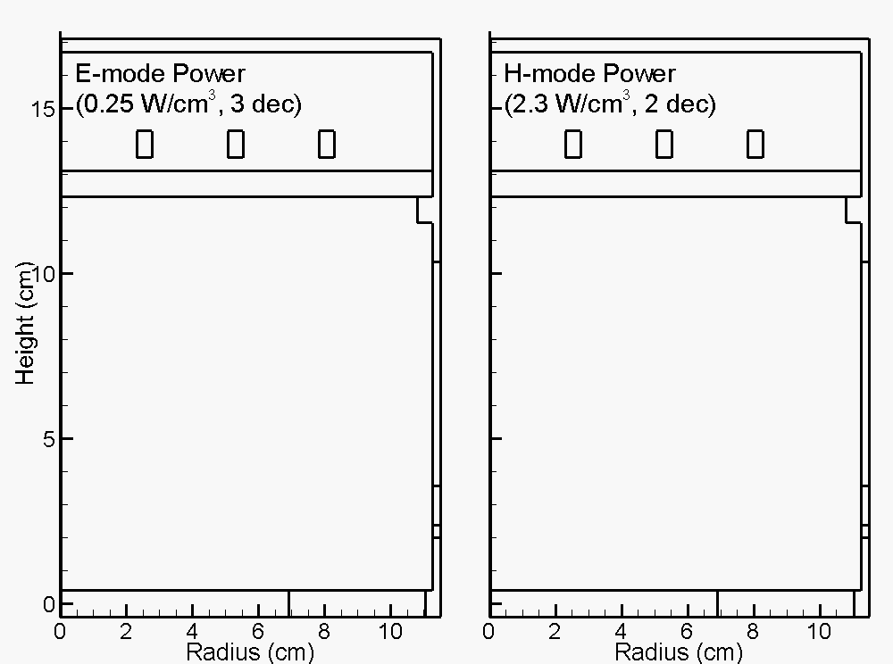
E-H TRANSITION DURING PULSED ICP
E-Mode Power
H-Mode Power
Pulsed ICPs in halogen gases have small electron densities at the start of the pulse.
The plasma starts in “E-mode” (capacitive) and transitions to “H-mode” (inductive).
Large change in Z_{Load} further complicates matching.
Ar/Cl₂ = 65/35, 25 mTorr, PRF = 13.3 kHz, Duty Cycle = 35%, Forward Power = 250 W.
0-50 μs
University of Michigan
Institute for Plasma Science & Engr.
Animation Slide
GEC_2018

Slide 11
PERFECT MATCH WITH E-H TRANSITION
Calculate C_{P} and C_{S} to provide a perfect match vs time.
Z_{L} has positive reactance from coil.
Initial E-mode operation requires smaller C_{S} as to match generator, Z_{G}.
Decrease in Z_{L} reactance during pulse due to capacitive coupling that contributes negative reactance.
Ar/Cl₂ = 65/35, 25 mTorr, PRF = 13.3 kHz, Duty Cycle = 35%, Forward Power = 250 W.
University of Michigan
Institute for Plasma Science & Engr.
GEC_2018

Slide 12
PERFECT MATCH WITH E-H TRANSITION
Calculate C_{P} and C_{S} to provide a perfect match vs time.
E-mode indicated by initial capacitive power dissipation resulting from initial low electron density.
Initial E-mode accompanied by large coil voltage, large oscillation in plasma potential.
H-mode starts with power dominated by inductive coupling.
Steady state has 5-10% capacitive power.
Ar/Cl₂ = 65/35, 25 mTorr, PRF = 13.3 kHz, Duty Cycle = 35%, Forward Power = 250 W.
University of Michigan
Institute for Plasma Science & Engr.
GEC_2018

Slide 13
EARLY MATCH WITH E-H TRANSITION
Choose C_{P} and C_{S} to provide a perfect match to Z_{G} at t = 3 μs near E- to H-mode transition.
Reflection coefficient Γ = 0 at match time enables rapid increase in delivered power.
Mismatch at later time during dominantly H-mode operation produces Γ = 0.25.
Ar/Cl₂ = 65/35, 25 mTorr, PRF = 13.3 kHz, Duty Cycle = 35%, Forward Power = 250 W.
University of Michigan
Institute for Plasma Science & Engr.
GEC_2018

Slide 14
MATCHING WITH
E-H TRANSITION
Choose “perfect match” values of C_{P,S} at different times.
Early match emphasizes capacitive coupling.
Later matches reduces capacitive coupling and delays inductive power with better overall match.
Ar/Cl₂ = 65/35, 25 mTorr, PRF = 13.3 kHz, Duty Cycle = 35%, Forward Power = 250 W.
University of Michigan
Institute for Plasma Science & Engr.
GEC_2018

Slide 15
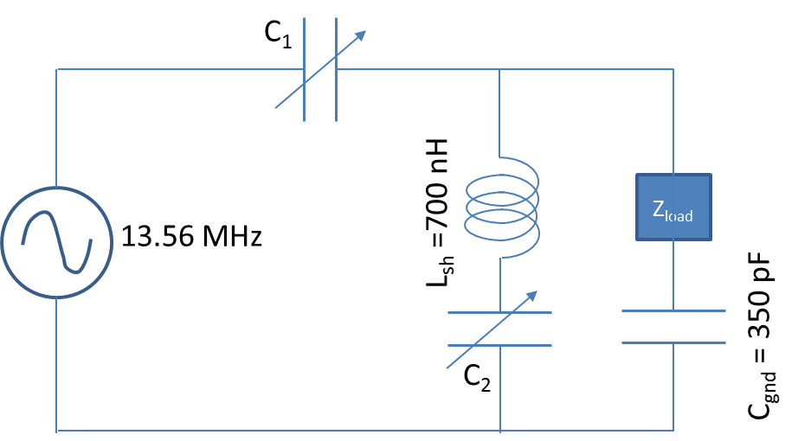
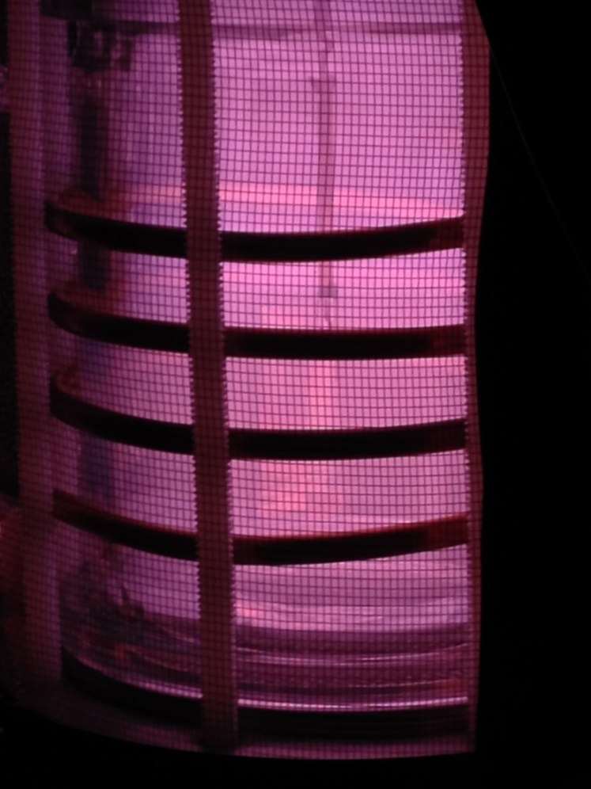
MATCHING PULSED PLASMAS
Reflection Coefficient
(Z₀=50 ohm)
During a pulsed ICP period, Z_{Load} changes.
Must choose values of C₁ and C₂ to match Z_{Load} at some point during pulsed period.
Demonstrate with Ar, pulsed ICP
University of Michigan
Institute for Plasma Science & Engr.
GEC_2018
Notes:
15

Slide 16
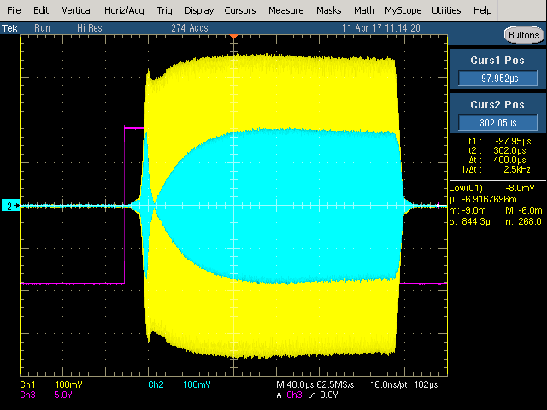
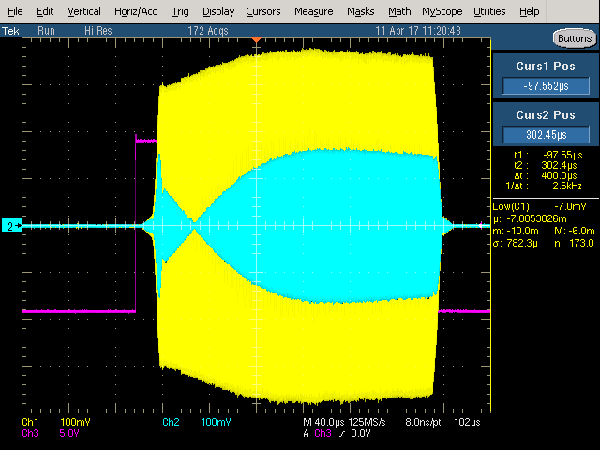
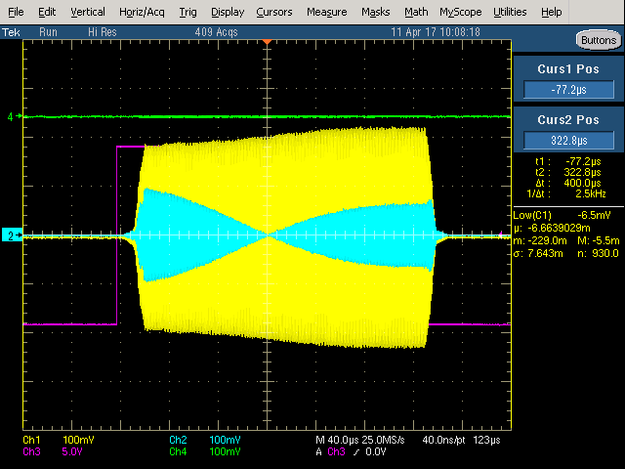
PULSED ICP, FIXED MATCHBOX
Power:
Yellow: Forward
Blue: Reflected
Match early in pulsed (Γ = 0), plasma density rises quickly but mismatch late in pulse when power is high – lower electron density.
Match late in pulse, plasma density rises slowly but higher [e] due to better match when power is high.
Ar, 5 mTorr
University of Michigan
Institute for Plasma Science & Engr.
GEC_2018
Notes:
Match point as indicator of degree of mismatch.
Scaling of plasma properties with different mismatch conditions-delayed match points.

Slide 17
MATCHING WITH E-H TRANSITION: DUTY CYCLE
[e]
Plasma Potential
Small duty cycle results in low electron density at start of next pulse, producing dominant E-mode, high impedance, large coil voltage.
Large oscillation in plasma potential with low duty cycle.
Large duty cycle – higher electron density at start of pulse and smoother transition to H-mode.
Ar/Cl₂ = 65/35, 25 mTorr, PRF = 13.3 kHz, Forward Power = 250 W.
University of Michigan
Institute for Plasma Science & Engr.
GEC_2018

Slide 18
IEDs ONTO WINDOW
The transient and large sheath voltage during the E-H transition produces energetic ion bombardment onto the dielectric window.
Ar/Cl₂ = 65/35, 25 mTorr, 13.3 kHz, 25% Duty Cycle, Forward: 250 W.
University of Michigan
Institute for Plasma Science & Engr.
GEC_2018

Slide 19
CONCLUDING REMARKS
Power delivery to inductively coupled plasmas (ICPs) is challenged by impedance matching for operation in either E-mode or H-mode.
During pulsed operation in attaching gases, low electron density at start of pulse translates to initial E-mode. As plasma density increases, transition occurs to H-mode.
Must typically choose match values Impedance matching network for some point in pulse.
Early matches emphasize capacitive power – poor H-mode match.
Late matches prevent power transfer early in pulse – better H-mode match.
E-mode producing large amplitude oscillations in plasma potential, producing ion acceleration into windows.
Some form of real-time impedance matching required during pulse – frequency tuning?
University of Michigan
Institute for Plasma Science & Engr.
GEC_2018

