Slide 1
OPTIMIZING UNIFORMITY IN PLASMA ETCHING OF HIGH ASPECT RATIO FEATURES BY
ENGINEERING THE FOCUS RING*
Shuo Huang and Mark J. Kushner
University of Michigan, Ann Arbor, MI 48109, USA
shuoh@umich.edu, mjkush@umich.edu
Seungbo Shim and Sang Ki Nam
Samsung Electronics Co., Republic of Korea
seungb.shim@samsung.com, sangki.j.nam@samsung.com
The 45th IEEE International Conference on Plasma Science,
Denver, Colorado, USA
24-28 June 2018
Work supported by Samsung Electronics Co., DOE Fusion Energy Science and National Science Foundation.
Notes:
1
1

Slide 2
AGENDA
Across-wafer uniformity
Effect of focus ring (FR)
Modeling platforms
Multi-frequency CCPs
Ion energy and angular distributions
Etch profiles
Optimizing uniformity through dielectrics under FR
Concluding remarks
University of Michigan
Institute for Plasma Science & Engr.
ICOPS_2018_S.Huang
Notes:
2
2

Slide 3
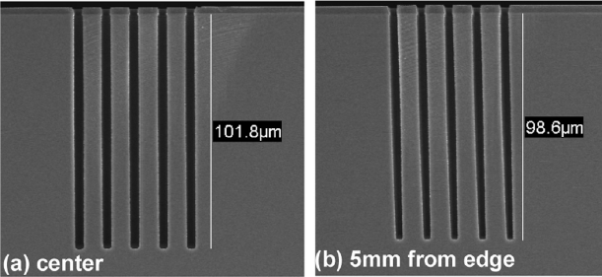
ACROSS-WAFER UNIFORMITY
As feature sizes shrink, etch profiles become increasingly sensitive to ion energy and angular distributions (IEADs).
Especially for high aspect ratio (HAR) features which require high bias power and high energy (~ a few keV) ions.
Plasma sheath/E-field bending at wafer edge, resulting in incident ions with tilted angles and tilted feature profiles.
Slight non-uniformity in reactant production and ion transport can persist down to the feature level.
Bending of sheath at wafer edge.
Vertical (center) and tilted (edge) profile.
Hwang and Kanarik, Solid State Technology, p16, July 2016.
Gambino et al., Microelectron. Eng. 135, 73 (2015).
University of Michigan
Institute for Plasma Science & Engr.
ICOPS_2018_S.Huang
Notes:
3
3

Slide 4
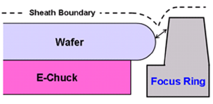
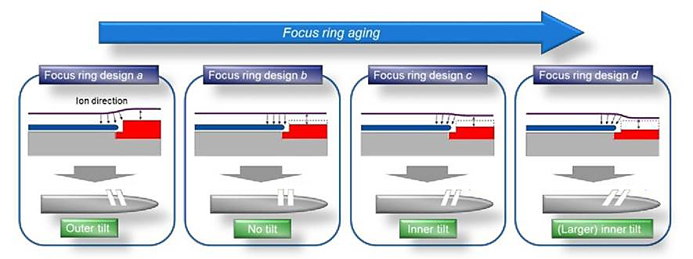
WAFER EDGE SURROUNDED BY FOCUS RING
The wafer edge is surrounded by focus ring (FR), which is mainly used to maintain uniform fluxes and IEADs to wafer.
Subtleties in the change of FR can have significant effect on across wafer uniformity.
As the FR is eroded during its lifetime, E-field at wafer edge and feature profiles change from outer tilting to inner tilting.
Wafer edge surrounded by FR.
Feature profile at edge evolving from outer to inner tilting with FR erosion.
Haren et al., Proc. SPIE 10589, 105890D (2018).
Wise, J. Micro/Nanolith. MEMS MOEMS 12, 041311 (2013).
University of Michigan
Institute for Plasma Science & Engr.
ICOPS_2018_S.Huang
Notes:
4
4

Slide 5
RESEARCH OBJECTIVES
Modeling of multi-frequency CCPs: ion energy and angular distributions and consequence on etch profiles
Height of FR
Wafer-FR gap
Optimizing uniformity by engineering FR using underlying dielectrics
University of Michigan
Institute for Plasma Science & Engr.
ICOPS_2018_S.Huang
Notes:
5
5

Slide 6
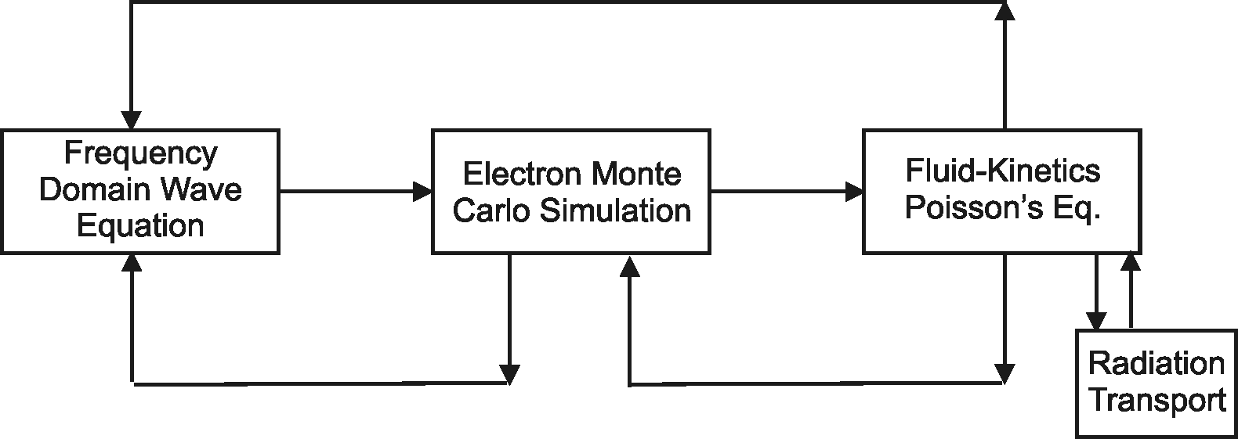
HYBRID PLASMA EQUIPMENT MODEL (HPEM)
Electron, Ion Cross Section Database
Plasma Chemistry
Monte Carlo Simulation
EMM
EETM
FKPM
Electron Energy Equation
Surface
Kinetics
Module
Hybrid Plasma Equipment Model (HPEM): A 2D modular simulator for reactor scale processes that combines fluid and kinetic approaches.
Electron Energy Transport Module (EETM): Electron energy equation solved for updating electron properties.
Fluid-Kinetics Poisson Module (FKPM): Momentum equations and Poisson’s equations solved for updating densities of species and electric potentials.
University of Michigan
Institute for Plasma Science & Engr.
ICOPS_2018_S.Huang

Slide 7
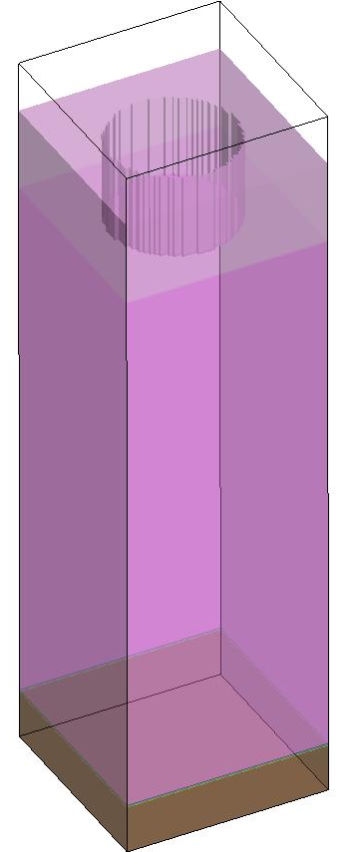
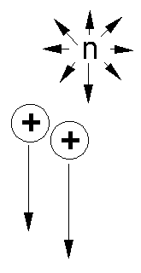
MONTE CARLO FEATURE PROFILE MODEL (MCFPM)
Multiscale model:
Reactor scale (HPEM): cm, ps-ns;
Sheath scale (PCMCM): μm, μs-ms;
Feature scale (MCFPM): nm, s.
MCFPM resolves surface topology on 3D Cartesian mesh. Each cell has a material identity.
Gas phase species are represented by Monte Carlo pseudoparticles, which are launched with energy and angular distributions obtained from HPEM.
Cell identities changed, removed or added for reactions such as etching and deposition.
Resist
SiO₂
Si
HPEM
PCMCM
MCFPM
n_{e}, T_{e}, EEDF, ion and neutral densities
Ion energy and angular distributions
Etch rates and etch profile
Reactor scale
Sheath scale
Feature scale
University of Michigan
Institute for Plasma Science & Engr.
ICOPS_2018_S.Huang

Slide 8
MULTI-FREQUENCY CCP REACTOR
Multi-frequency CCP reactor modeled using 2-dimensional HPEM.
Top electrode: 80 MHz, 200 V.
Bottom electrode: 10/5 MHz = 800/800 V.
Gas mixtures: Ar/C₄F₈/O₂ = 75/15/10, 500 sccm, 25 mTorr.
100 mm wafer confined by Si focus ring with gap of 1 mm in between.
Dielectric under focus ring: ε = 2 – 40. (4 for base case: quartz)
Conductivity (1/Ω-cm): wafer: 10⁻², FR: 10⁻⁵, dielectric: 10⁻¹⁵.
University of Michigan
Institute for Plasma Science & Engr.
ICOPS_2018_S.Huang
Notes:
8

Slide 9
MULTI-FREQ CCP – PLASMA PROPERTIES
Electron density peaks at the edge of the wafer due to field enhancement.
Electrons are mainly produced through ionization by bulk electrons.
Debye length at the wafer edge is ~ 0.5 mm, smaller than the gap size (1 mm).
Some plasma molding into the wafer-FR gap.
Ions accelerated into gap, resulting in erosion of consumable parts.
University of Michigan
Institute for Plasma Science & Engr.
ICOPS_2018_S.Huang
Notes:
9

Slide 10
MULTI-FREQ CCP – POTENTIAL, E-FIELD
E-field perpendicular to wafer surface resulting from conformal sheath except at edge where tilting occurs.
At wafer edge, sheath bending downwards due to plasma molding into gap.
Potential drop inside FR in the radial direction, leading to horizontal component for E-field around the wafer edge and so incident ions with tilted angles.
University of Michigan
Institute for Plasma Science & Engr.
ICOPS_2018_S.Huang
Notes:
10

Slide 11
FLUXES TO GAP SURFACE – IONS, RADICALS
Decreased electron and ion fluxes (instantaneous fluxes) to the gap surface due to partial molding of the plasma.
C_{x}F_{y} radical fluxes into the gap decrease less significantly than ions, resulting in large C_{x}F_{y}/ion flux ratio and enhanced deposition inside gap.
ICOPS_2018_S.Huang
Notes:
11

Slide 12
IEADs – WAFER CENTER TO EDGE
Center
Mid-radius
Edge
High energy ions (400 to 1500 eV).
Gradient in plasma sheath from center to edge.
From center to edge, IEAD varies from symmetric to asymmetric (inward tilting).
Symmetric IEAD at wafer center due to symmetric fluxes and perpendicular E-field to surface.
IEAD at edge becomes inward skewed by about 2 – 4º due to sheath bending.
University of Michigan
Institute for Plasma Science & Engr.
ICOPS_2018_S.Huang
Notes:
12

Slide 13
ETCH PROFILES – WAFER CENTER TO EDGE
Time evolution of etch profiles from center to edge.
At wafer center, anisotropic profile with no tilting due to symmetric IEADs.
At wafer edge, asymmetry in IEADs persists down into the features.
Unequal mask erosion at different sides.
Bowing in upper portion of feature due to reflected ions.
Tilted etch front.
Animation
Slide
University of Michigan
Institute for Plasma Science & Engr.
ICOPS_2018_S.Huang
Notes:
13

Slide 14
POS. IONS, ELECTRIC POTENTIAL – FR HEIGHT
High FR
Medium FR
Low FR
When FR is high, shielding of plasma out of the wafer-FR gap.
Less plasma molding into gap. Sheath at wafer edge is upward bending.
When FR is low, electric potential is more skewed in the horizontal direction, resulting in ions with more tilted angles.
University of Michigan
Institute for Plasma Science & Engr.
ICOPS_2018_S.Huang

Slide 15
IEADs AT WAFER EDGE – FR HEIGHT
FR is eroded as reactor is used for processing hundreds of wafers.
As height of FR decreases, ion angular distributions change from slightly outward tilting to inward tilting.
Little variation for IEDs at wafer edge.
IEAD collected
ICOPS_2018_S.Huang
Notes:
15

Slide 16
ETCH PROFILES AT WAFER EDGE – FR HEIGHT
High FR
Medium FR
Low FR
The transition of the profiles corresponds well with IEADs.
When FR is new and high, feature is slightly outward tilting.
As FR is reused and height of FR decreased, profile becomes inward tilting.
IEAD collected
Animation
Slide
University of Michigan
Institute for Plasma Science & Engr.
ICOPS_2018_S.Huang
Notes:
16

Slide 17
POS. IONS, ELECTRIC POTENTIAL – GAP: 1 – 2 mm
Small gap
Medium gap
Large gap
As the gap size becomes larger compared with the Debye length (~ 0.5 mm), the sheath becomes more conformal to the gap surface.
More plasma molding into the gap, resulting in enhanced erosion of the focus ring.
University of Michigan
Institute for Plasma Science & Engr.
ICOPS_2018_S.Huang

Slide 18
IEADs AT WAFER EDGE – GAP SIZE: 1 – 2 mm
As FR is eroded, wafer-FR gap increases, allowing plasma penetrating into the gap and conformal to surface.
As gap size increases, IADs at wafer edge becomes more tilted.
IEDs at edge vary little with gap size.
IEAD
ICOPS_2018_S.Huang
Notes:
18

Slide 19
PROFILES AT WAFER EDGE – GAP SIZE: 1 – 2 mm
Small gap
Medium gap
Large gap
As gap size increases, features become slightly more tilted, which corresponds well with the IEADs.
Feature profiles at edge sensitive to FR geometries.
IEAD
Animation
Slide
University of Michigan
Institute for Plasma Science & Engr.
ICOPS_2018_S.Huang
Notes:
19

Slide 20
IEADs AT FR SURFACES
Wafer-FR gap
FR top surface
FR right surface
FR is mainly eroded by physical sputtering and chemically enhanced etching.
Slight ion flux into gap, resulting in sparse IEAD.
On all surfaces, incident ions have broad and asymmetric IEADs.
Reducing the ion energy or the ion flux is a possible solution to protect the focus ring (maintain high FR and small gap).
University of Michigan
Institute for Plasma Science & Engr.
ICOPS_2018_S.Huang
Notes:
20

Slide 21
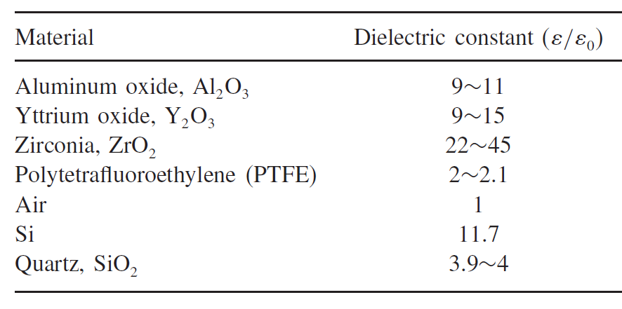
FOCUS RING KIT – UNDERLYING DIELECTRICS
Capacitance of plasma sheath above FR is in series with cap. of FR and underlying dielectrics (FR kit).
Opportunities to tune sheath potential and IEADs through underlying dielectrics.
Minimizing the effect on other parameters.
Parameterization:
ε = 2, 4, 10, 20, 30, 40.
Plasma sheath
FR
Dielectric
University of Michigan
Institute for Plasma Science & Engr.
ICOPS_2018_S.Huang
Notes:
21

Slide 22
ELECTRIC POTENTIAL, POS. IONS – ε = 2, 40
Low-k, ε=2
High-k, ε=40
For low-k dielectric, electric potential in FR is more skewed, resulting in lower sheath potential (thinner sheath) at FR surface.
Lower ε results in lower capacitance, which shares more voltage drop inside dielectric, so smaller sheath potential.
University of Michigan
Institute for Plasma Science & Engr.
ICOPS_2018_S.Huang
Notes:
22

Slide 23
IEDs AT FR SURFACES – ε = 2 – 40
IEDs incident into wafer-FR gap almost not affected by varying dielectric.
For top and right surface of FR, IEDs decrease by about 200 eV.
Increased potential drop in dielectric and decreased sheath potential at focus ring surface.
Significant decrease of ion energy alleviates the consumption of FR by plasma.
Wafer-FR gap
FR top surface
FR right surface
ε = 2 – 40
University of Michigan
Institute for Plasma Science & Engr.
ICOPS_2018_S.Huang
Notes:
23

Slide 24
CONCLUDING REMARKS
Computational investigation on a multi-frequency capacitively coupled plasmas (MF-CCP) sustained in Ar/C₄F₈/O₂ mixtures while varying the properties of the FR kit.
Feature profiles at wafer edge are sensitive to focus ring geometries.
As FR height decreases, IADs at wafer edge varies from outward to inward tilting due to modulated sheath profile at wafer edge.
As wafer-FR gap size increases, IADs at wafer edge becomes more tilted due to more plasma molding into the gap.
Maintaining geometry of FR (height and small wafer-FR gap) is critical in maintaining across-wafer uniformity.
Varying the underlying dielectric from high-k to low-k, the sheath potential at FR surface decreases, resulting in better protection of FR and less tilted profiles.
University of Michigan
Institute for Plasma Science & Engr.
ICOPS_2018_S.Huang
Notes:
24
24

