Slide 1
ADDRESSING PLASMA-LIQUID INTERACTIONS IN A GLOBAL MODEL: CAPABILITIES AND LIMITATIONS*
Amanda M. Lietz^{a)}, Wei Tian^{a)}, and Mark J. Kushner^{b)}
^{a)}Department of Nuclear Engineering and Radiological Sciences
^{b)}Department of Electrical Engineering and Computer Science
University of Michigan, Ann Arbor, MI 48109, USA
lietz@umich.edu, bucktian@umich.edu, mjkush@umich.edu,
http://uigelz.eecs.umich.edu
International Symposium on Plasma Chemistry
Antwerp, Belgium
6 July 2015
* Work was supported by the DOE Office of Fusion Energy Science and the National Science Foundation

Slide 2
AGENDA
Plasma-Liquid Interactions
Description of Model
Comparison with nonPDPSIM
Base Case: ROS and RNS production
Consequences of:
Voltage
Gas Flow
Biomolecules
Concluding Remarks
University of Michigan
Institute for Plasma Science & Engr.
ISPC 2015

Slide 3
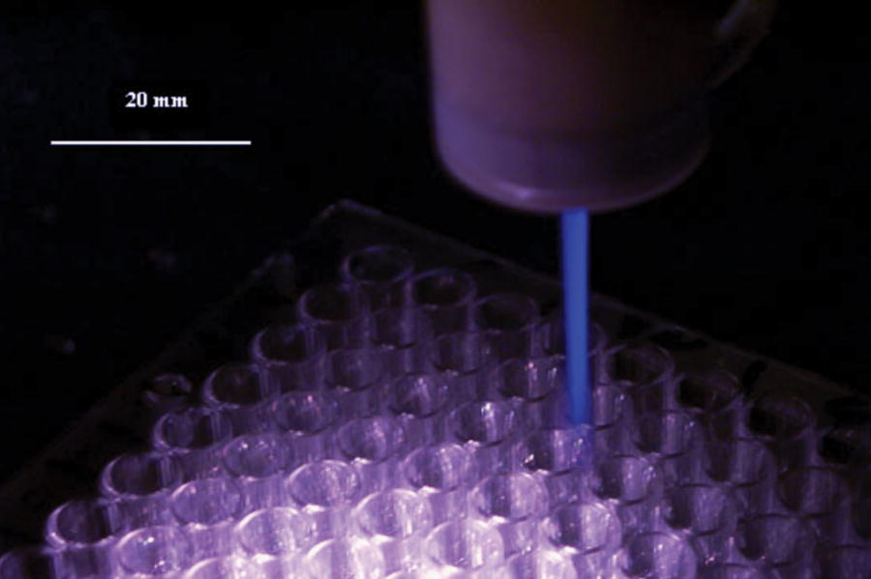
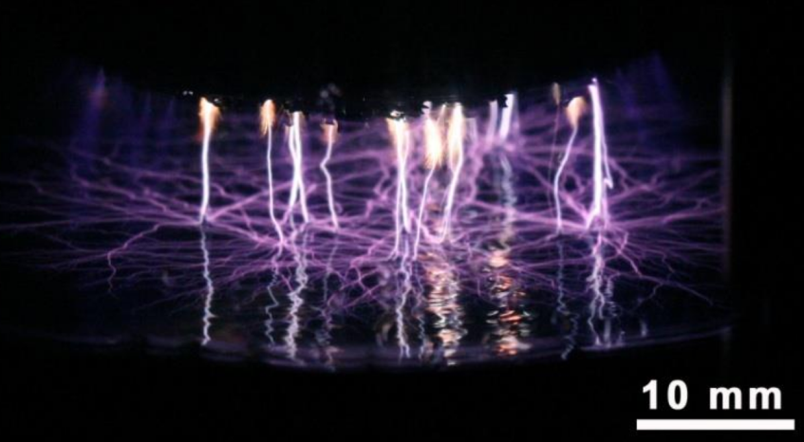
PLASMA LIQUID INTERACTIONS
Use of Dielectric Barrier Discharges (DBDs) in medical applications typically treat tissue covered with liquid.
Sanitizing wounds without tissue damage
Reducing size of tumors
Eradicating bacteria in biofilms
Reactive oxygen and nitrogen species (RONS) produced by plasma and reaching tissue are processed by the liquid.
Efficacy of these systems depends on long-term plasma produced, liquid phase chemistry.
M. Laroussi, et al. Plasma Process. Polym., 3, 470 (2006).
P. Lukes, et al. IEEE Trans. Plasma Sci. 39, 2644 (2009).
University of Michigan
Institute for Plasma Science & Engr.
ISPC 2015
Notes:
Application for atm discharges

Slide 4
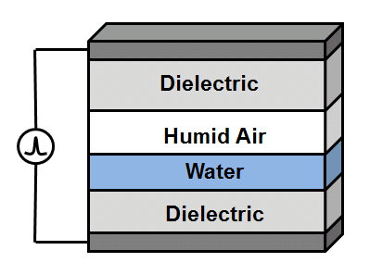
AIR DBD ON LIQUID COVERED TISSUE
Knowledge of RONS present in a liquid layer over a wound at long timescales is critical to understanding the mechanisms involved in plasma medicine.
We will computationally investigate a humid air DBD over water using a global model.
The effect of voltage, gas flow rate, and biomolecules on the RONS in the liquid will be explored.
Gas flow selectively decreases the densities of species, based on Henry’s law constants.
Biomolecules in the liquid rapidly consume ROS in the liquid, increasing the transport into the liquid.
University of Michigan
Institute for Plasma Science & Engr.
ISPC 2015
Notes:
Application for atm discharges

Slide 5
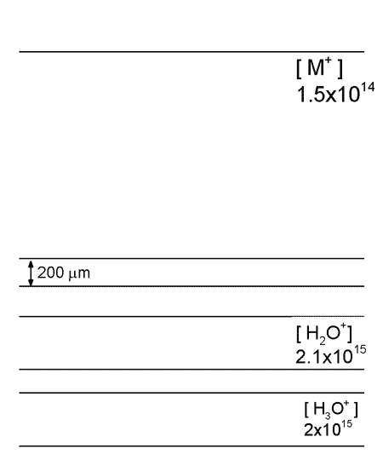
COMPUTATIONAL APPROACHES
Many phenomena require multi-dimensional modeling to address proper scaling.
Complex chemistries and 1000s pulses are computationally challenging in 2-D models.
Global models enable more rapid analysis of reaction mechanisms and scaling laws.
Disadvantages:
Unable to capture mixing between highly non-uniform gas mixtures
Does not easily resolved ionization wave behavior.
• 2-D: Up to days CPU for 10s ns
• Global: 5,000 pulses, 0.5 s, < 1 day
University of Michigan
Institute for Plasma Science & Engr.
Animation Slide
ISPC 2015

Slide 6
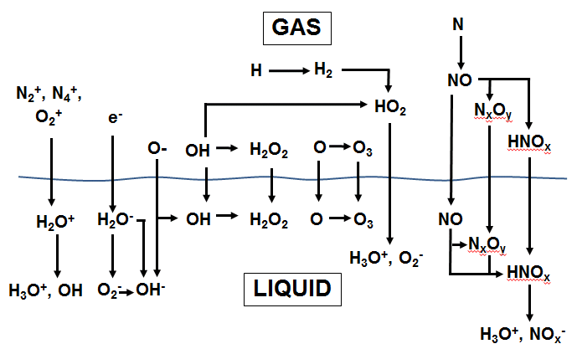
REACTION MECHANISM
In gas, e⁻ impact reactions for ions, H, O, OH, H, N, O₂⁻, O₂*, and O⁻
O₃ and H₂O₂ are relatively stable ROS, formed in 2 steps
N_{x}O_{y} and HNO_{x} are formed in at least 3 steps, often more
University of Michigan
Institute for Plasma Science & Engr.
ISPC 2015

Slide 7
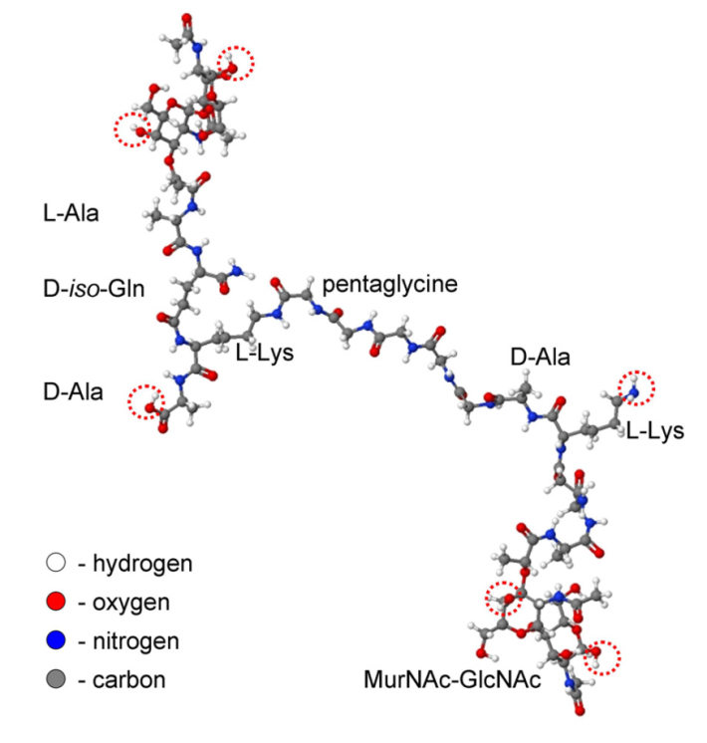
ORGANICS IN LIQUID: PEPTIDOGLYCAN
Chains of peptidoglycan (PG) make up the cell wall bacteria
MD simulations of interactions with O, OH, H₂O₂, and O₃ provide reaction rates (M. Yusupov, et al., J. Phys. Chem. C 117, 5993 (2013))
Reactions with ROS are categorized by bond breaking (C-O,C-C, C-N)
In this study, rates are calculated for pristine PG molecules only, subsequent reactions have higher rates (≈10X).
Peptidoglycan (PG)
Calculated Rate Coefficients for Reactions with Peptidoglycan [cm³/s]
Radical | C-O breaking | C-C breaking | C-N breaking
O | 6.35 × 10⁻¹⁰ | 3.43 × 10⁻¹⁰ | 3.96 × 10⁻¹⁰
OH | 5.42 × 10⁻¹⁰ | 2.92 × 10⁻¹⁰ | 8.20 × 10⁻¹⁰
O₃ | 4.80 × 10⁻¹⁰ | 2.63 × 10⁻¹⁰ | 4.74 × 10⁻¹⁰
H₂O₂ | 2.32 × 10⁻¹⁰ | 1.55 × 10⁻¹⁰ | -
University of Michigan
Institute for Plasma Science & Engr.
ISPC 2015

Slide 8
MODELING PLATFORM: GlobalKIN
Plasma is a well-stirred reactor
Electron temperature:
Species densities:
Diffusion with multiple surfaces having unique sticking coefficients (S_{im}) and return fractions (g_{ikm}) for each species.
Circuit module, plug flow, and a surface kinetics modules.
University of Michigan
Institute for Plasma Science & Engr.
ISPC 2015
Notes:
8
8

Slide 9
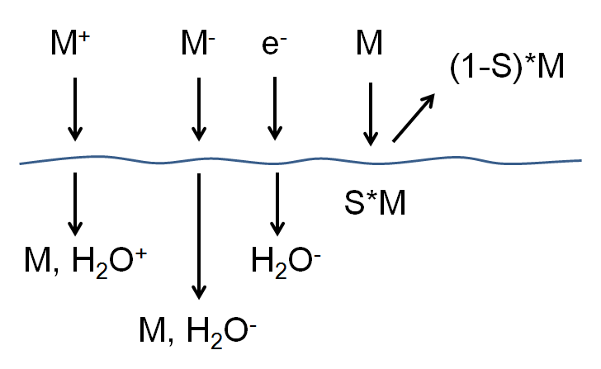
GlobalKIN LIQUID MODULE
Liquid is treated as separate "zone" with its own reaction mechanism.
Transport from gas to liquid is through an interfacial surface.
From gas plasma’s perspective, interface is analogous to a reactive surface, with a sticking coefficient and a return flux.
All charged species diffusing to liquid surface solvate.
Water evaporates into gas phase.
"Sticking" gas phase species enter liquid.
Sticking coefficient, S, based on Henry’s law limited transport into liquid:
University of Michigan
Institute for Plasma Science & Engr.
ISPC 2015
Notes:
9
9

Slide 10
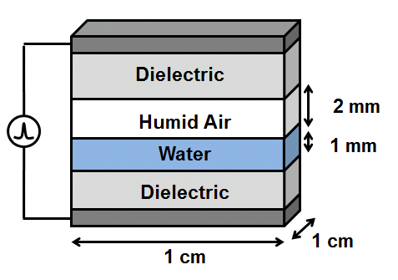
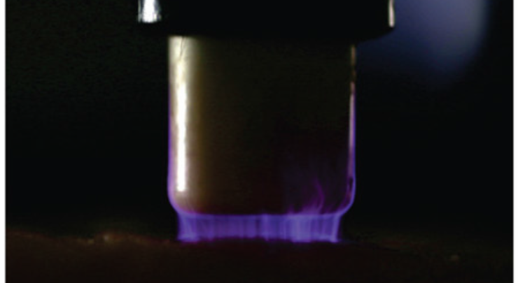
BASE CASE: DBD TREATING TISSUE
Gas reaction mechanism: N₂/O₂/H₂O, 54 species, 396 reactions
Liquid Mechanism: N₂/O₂/H₂O/Peptidoglycan, 49 species, 99 reactions
Gas: N₂/O₂/H₂O = 77/20/3
Liquid: H₂O with 5 ppm O₂ and 9ppm N₂
Pulsed DC, 10 kHz, 20 kV
192 μJ/pulse (958 μJ/cm³).
Average power 1.9 W (9.6 W/cm³)
Optional gas flow
S. Baldus, et al. J. Phys. D, 48, 275203 (2015).
University of Michigan
Institute for Plasma Science & Engr.
ISPC 2015

Slide 11
SINGLE PULSE: ROS
O, O⁻, O₂*, and OH are generated by e⁻ impact during the pulse
O₂⁻, HO₂, O₃, H₂O₂ are secondary products of O, O⁻, and OH
These more stable species diffuse into liquid in 100s of ms.
O₃ and O₂* become saturated in the liquid
O₂⁻ accumulates in the liquid
HO₂ + H₂O → O₂⁻ + H₃O⁺
University of Michigan
Institute for Plasma Science & Engr.
ISPC 2015

Slide 12
SINGLE PULSE: RNS
Gas RNS form later than ROS as multiple reactions required for N_{x}O_{y}, HNO_{x.}
NO₂ and NO₃ solvate into liquid, and form HNO_{2aq} and HNO_{3aq} by reaction with H₂O.
HNO_{3aq}, ONOOH_{aq}, and HNO_{2aq} hydrolyze to form H₃O⁺, NO_{x}⁻_{aq}, lowering pH.
Simulations at long timescales are necessary to represent RNS in liquid.
University of Michigan
Institute for Plasma Science & Engr.
ISPC 2015

Slide 13
MULTIPLE PULSES
Ions and the most reactive neutrals have a short lifetime and are consumed between pulses.
O, OH, N, N2*, O*, H
More stable species accumulate with every pulse.
O₃, H₂O₂, N₂O, H₂, HNO₃, H₃O⁺_{aq}, NO₃⁻_{aq,}ONOO⁻_{aq}
The other species have a lifetime longer than the interpulse period, but still decay between pulses
OH_{aq}, O₂*…
University of Michigan
Institute for Plasma Science & Engr.
ISPC 2015
Notes:
Humidity:

Slide 14
GlobalKIN vs. 2d-nonPDPSIM: LIQUID SPECIES
Single DBD filament onto liquid covered tissue, 18 kV.
In nonPDPSIM, boundary layer at top of liquid quickly saturates with RONS at Henry's law equilibrium.
Saturation slows rate of diffusion of RONS into liquid.
In GlobalKIN, liquid is well-stirred with no limiting boundary layer.
RONS densities saturate later and at higher values.
University of Michigan
Institute for Plasma Science & Engr.
ISPC 2015

Slide 15
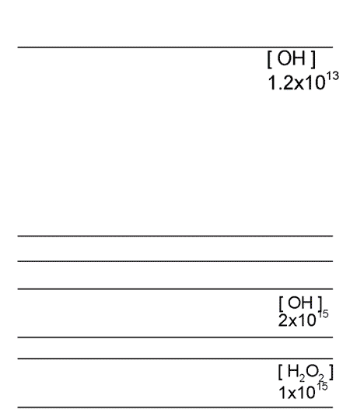
BOUNDARY LAYER FORMATION IN 2d-nonPDPSIM
nonPDPSIM does not include flow or mixing in the liquid, transport is by diffusion only
OH_{aq} is produced at top of water by diffusion from gas phase and
H₂O⁺_{aq} +H₂O_{aq} →H₃O⁺_{aq}+ OH_{aq}
H₂O_{aq} + hν → H_{aq}+ OH_{aq}
OH_{aq} quickly converted to H₂O_{2aq}
-18 kV, 3 x 100 Hz pulses, 1 s afterglow, 200 μm water, O_{2aq} 8 ppm (3 dec)
MIN MAX
University of Michigan
Institute for Plasma Science & Engr.
Log scale
ISPC 2015
Animation Slide
Notes:
15
From Wei Tian GEC 2013, slide 20

Slide 16
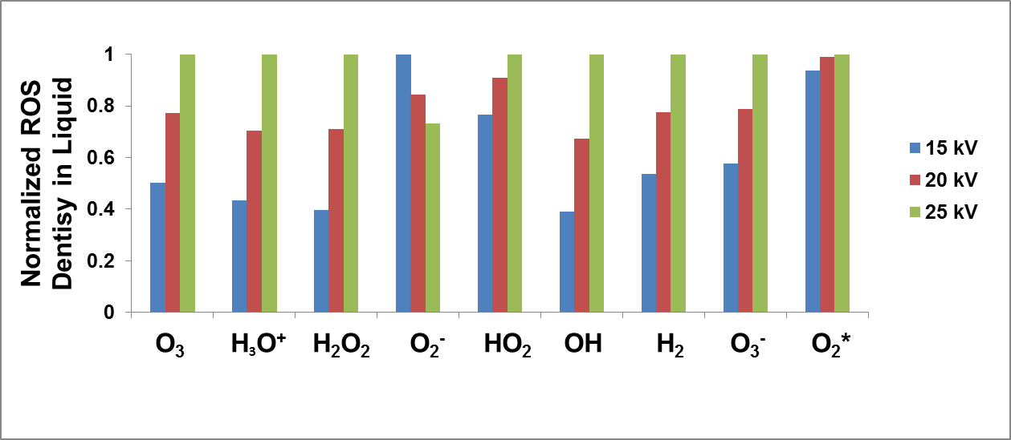
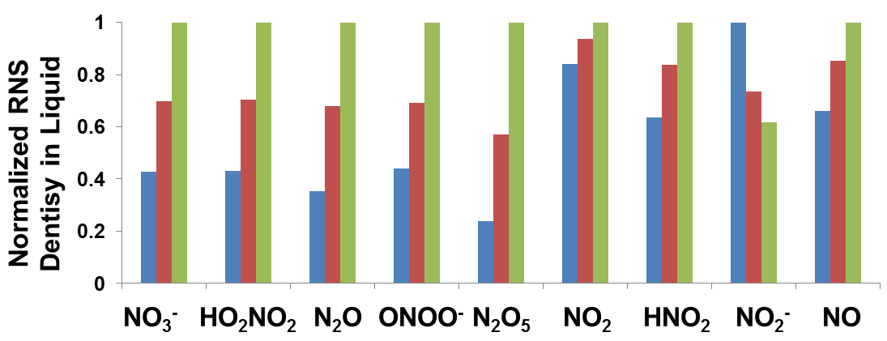
LIQUID DENSITIES vs VOLTAGE
Liquid densities at 0.5 s (5,000 pulses)
Increase 15 kV to 25 kV is 2.8 increase in energy.
Most of the RONS_{aq} scale with energy.
O₂⁻ decreases with energy as it reacts with O₂* and O.
HNO₂ is a weak acid which buffers the solution
As H₃O⁺ increases with voltage (from HNO₃), less HNO₂ dissociates into NO₂⁻.
High
Density
Low
Density
University of Michigan
Institute for Plasma Science & Engr.
ISPC 2015
Notes:
All gas phase RONS examined increase with energy except O2-
explain why some species decrease with energy or increase at slower rate then increase in energy.

Slide 17
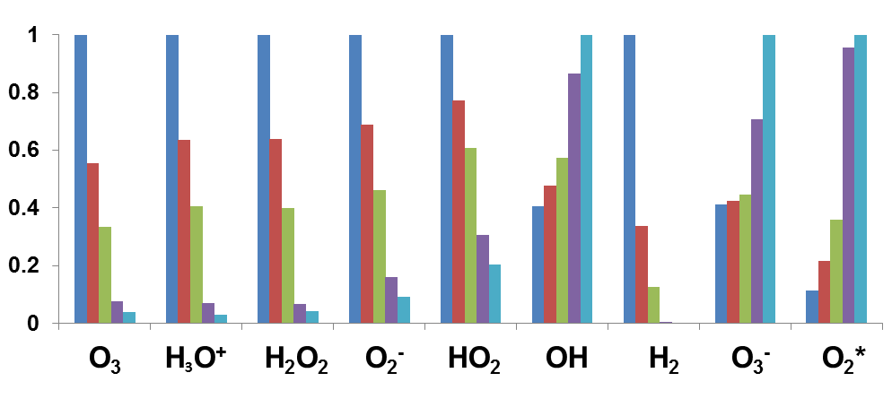
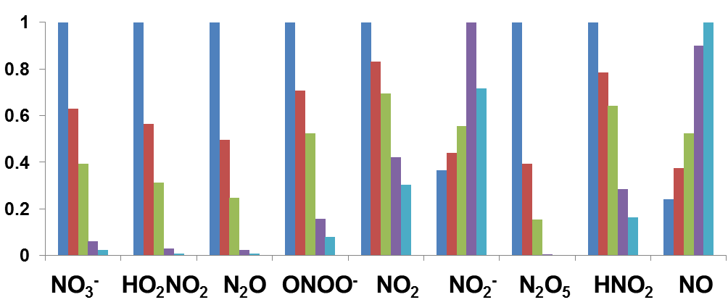
LIQUID DENSITIES vs GAS FLOW RATE
10kHz, 20kV, 0.5 s (5,000 pulses)
Inlet gas 50% RH: 10 -1000 sccm (12 ms – 1.2 s res. time)
Gas RONS flow out between pulses – decreases NO_{x}, HNO_{y} which require multiple reactions.
[H₂O]_{gas} does not saturate by evaporation. Lower [H₂O] produces higher n_{e}.
O₂*, OH, and NO have low Henry’s law values, saturate in liquid in time shorter than gas residence time.
NO₂⁻ increases with flow as not rapidly consumed by reaction with H₂O₂
High
Density
Low
Density
University of Michigan
Institute for Plasma Science & Engr.
ISPC 2015
Notes:
What is residence time for XX sccm
Consider running intermediate sccm. These values of x10 and x100, which are pretty big jumps. Fir exanokem tii gard ti explain 1 jump in O3-

Slide 18
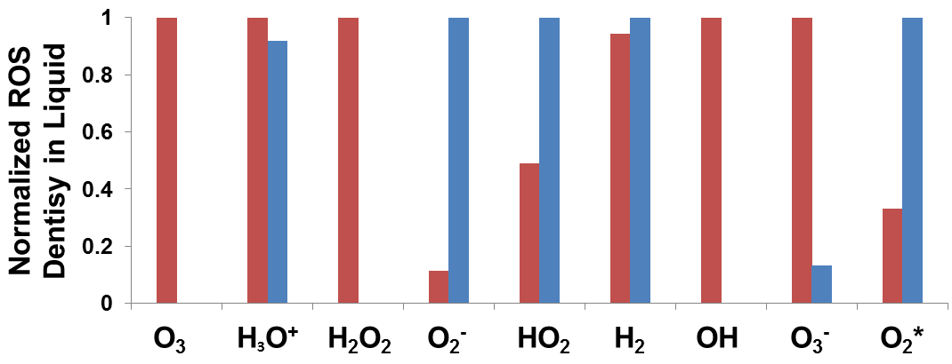
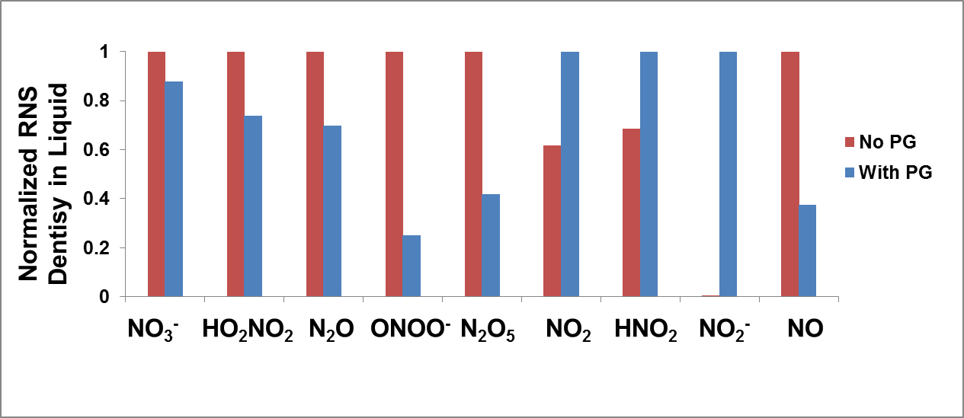
BIOMOLECULES IN LIQUID
10kHz, 20kV, 0.5 s (5000 pulses)
Peptidoglycan (10 ppm)
Rapid consumption of OH, O₃, O, H₂O₂
Species reacting with these radicals increase when PG is added.
HNO₂ and NO₂⁻ increase because NO₂ is increased
O₂⁻ + OH → O₂ + OH⁻
HO₂ + OH → O₂ + H₂O
O₂* + O₃ → O₂ + O₂ + O
NO₂ + OH → HNO₃
2NO₂+2H₂O → H₃O⁺ + NO₃⁻ +HNO₂
HNO₂ + H₂O → H₃O⁺ + NO₂-
University of Michigan
Institute for Plasma Science & Engr.
ISPC 2015

Slide 19
CONCLUDING REMARKS
Plasma-liquid interactions addressed by global model enable addressing long times and complete reaction mechanism appropriate for well-stirred system.
Spatially dependent models better represent spatially dependent rate limiting processes at surface.
In a DBD interacting with a liquid water layer:
Voltage – increases the energy deposition and reactivity produced, with the exception of NO₂⁻ (a pH buffer) and O₂⁻, which reacts with other ROS.
Gas flow – reduces the H₂O gas density and species flow out between pulses. The liquid density of species with Henry’s law constants low enough to saturate faster than the gas residence time are unaffected by flow.
Biomolecules – Peptidoglycan rapidly consumes OH, O, H₂O₂, and O₃, indicating in a transfer of reactivity from the plasma to the biomolecule. Densities of species which react with these species, O₂⁻, H₂O₂, O₂* and NO₂, increase with PG.
ISPC 2015

