Slide 1
Helium Atmospheric Pressure Plasma Jet Dynamics: Consequences of Ground Placement*
Amanda M. Lietz, Seth A. Norberg, and Mark J. Kushner
^{a)}Department of Nuclear Engineering and Radiological Sciences
^{b)}Department of Electrical Engineering and Computer Science
University of Michigan, Ann Arbor, MI 48109, USA
lietz@umich.edu, norbergs@umich.edu, mjkush@umich.edu, http://uigelz.eecs.umich.edu
International Symposium on Plasma Chemistry
Antwerp, Belgium
6 July 2015
* Work was supported by the DOE Office of Fusion Energy Science and the National Science Foundation

Slide 2
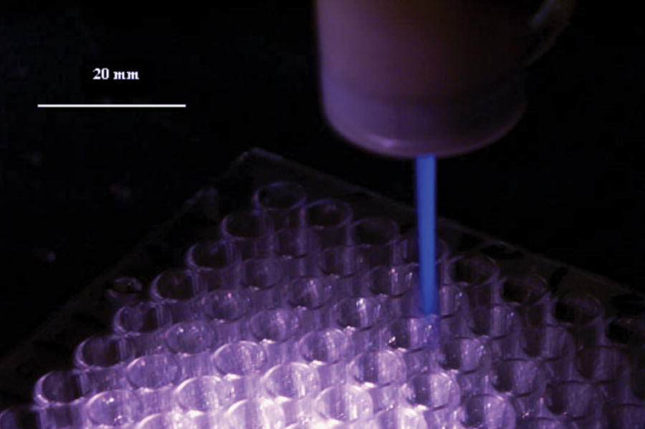
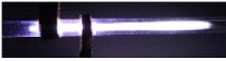
ATMOSPHERIC PRESSURE PLASMA JETS
Atmospheric pressure plasma jets (APPJs) have been studied for:
  Sanitizing wounds without tissue damage
  Reducing size of cancerous tumors
  Eradicating bacteria in biofilms
Rare gas with small amounts of O₂ to increase reactive oxygen and nitrogen species (RONS) production
Control of RONS production is key to influencing biological systems.
• Laroussi, M. et al. Plasma Process. Polym., 3, 470 (2006)
Mariotti Research Group
University of Michigan
Institute for Plasma Science & Engr.
ISPC 2015
Notes:
Application for atm discharges

Slide 3
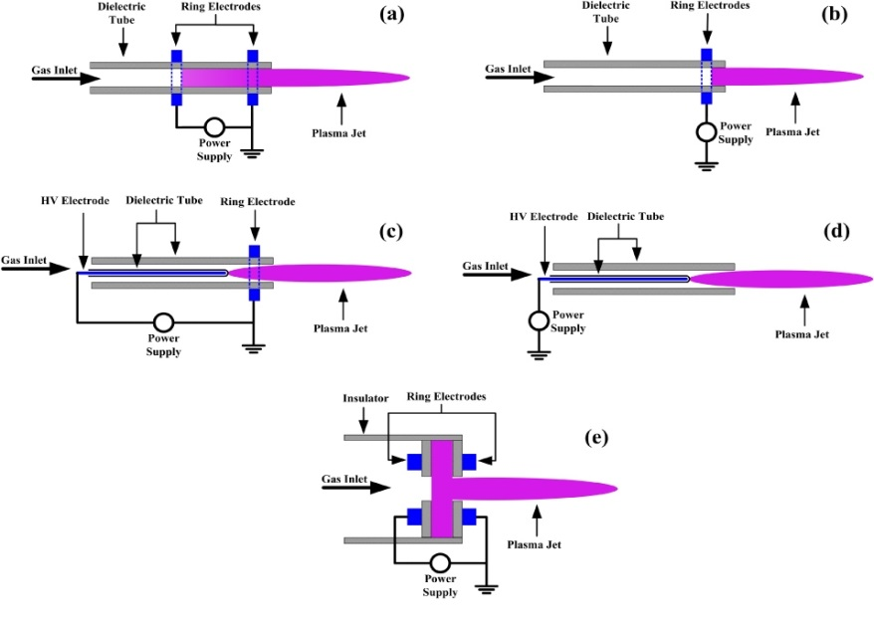
CONTROL OF APPJ PROPERTIES
There are many designs for APPJs
  Placement of electrodes
  Materials
  Locations of ground planes
Few studies on effect of electrode configurations on APPJ properties.
This makes side-by-side comparisons and optimization of fluxes challenging.
• X Lu et al Plasma Sources Sci. Technol. 21, 034005 (2012)
Objective: Start with basics of operation
  Ionization wave (IW) formation in one-ring and two-ring electrode APPJ studied with computational modelling.
  Investigate the effects of electrode configuration on the IW and RONS production.
University of Michigan
Institute for Plasma Science & Engr.
ISPC 2015
Notes:
Application for atm discharges

Slide 4
MODEL:
nonPDPSIM
Plasma Hydrodynamics
Poisson’s Equation
Gas Phase Plasma
Bulk Electron Energy
Transport
Kinetic “Beam”
Electron Transport
Unstructured mesh.
Fully implicit plasma transport.
Time slicing algorithms between plasma and fluid timescales.
Neutral Transport
Navier-Stokes
Neutral and Plasma
Chemistry
Radiation Transport
Surface Chemistry
and Charging
Ion Monte Carlo
Simulation
Circuit Model
University of Michigan
Institute for Plasma Science & Engr.
ISPC 2015
Notes:
4
4

Slide 5
GAS FLOW and MESH
Cylindrically symmetric
80 ns, -20 kV pulse
  He/O₂ (10 ppm), 1 atm, 2 slm into humid air
  ɛ_{r} = 8 (glass), 250 µm thick
4 mm gap between rings
Steady-state flow established before plasma
Reaction mechanism: He/N₂/O₂/H₂O, 51 species, 513 reactions
11,201 nodes, spacing 50 µm in plasma
MIN MAX
Log scale
University of Michigan
Institute for Plasma Science & Engr.
ISPC 2015
Notes:
Humidity:

Slide 6
EFFECT OF DOWNSTREAM GROUND ON n_{e}
Inelastic collisions with N₂, O₂, H₂O attenuate plasma as it propagates out of the tube
Ionization wave (IW) slower outside of tube with grounded ring due to lower E/N outside of tube
n_{e} in tube 10x higher with grounded ring as E/N is higher within the tube
n_{e} outside tube minimally affected by grounded ring
n_{e} more annular with grounded ring, axial component of E-field decreased
MIN MAX
Log scale
University of Michigan
Institute for Plasma Science & Engr.
P: powered electrode
ISPC 2015

Slide 7
EFFECT OF DOWNSTREAM GROUND ON T_{e}
T_{e} outside of tube is higher without grounded ring as E/N is higher outside of tube due to larger axial field.
T_{e} inside of tube quenches faster with grounded ring.
n_{e} is larger, plasma is more conductive and provides more shielding, and so E/N drops faster.
With ground ring, more low-threshold energy (N₂(v)) and fewer high-threshold energy species (N, O, N₂*, O₂*) produced.
MIN MAX
Linear scale
University of Michigan
Institute for Plasma Science & Engr.
ISPC 2015

Slide 8
EFFECT OF UPSTREAM GROUND ON n_{e}
n_{e} in tube 10x higher with grounded ring
IW propagates in both directions with and without grounded ring, current is divided
E/N in tube is larger with grounded ring, so more current travels upstream, n_{e} outside of tube lower
IW speed outside tube is up to 50% higher without grounded ring, more charge on inside wall shielding powered electrode
  1 × 10⁸ cm/s without ground
  7 × 10⁷ cm/s with ground
MIN MAX
Log scale
University of Michigan
Institute for Plasma Science & Engr.
ISPC 2015

Slide 9
EFFECT OF UPSTREAM GROUND ON T_{e}
Circuit equivalent of adding a grounded ring is increasing C₁ by several orders of magnitude, so voltage across R_{plasma,ambient} more rapidly decreases.
With grounded ring, max T_{e} outside of tube unaffected, but T_{e} more rapidly drops, as C₂ charges.
MIN MAX
Linear scale
University of Michigan
Institute for Plasma Science & Engr.
ISPC 2015

Slide 10
POSITIVE IONS
  At 25 ns
  To increase M⁺ density inside tube:
  Add grounded ring
  Power the lower electrode
  To increase M⁺ density outside tube:
  No grounded ring
  Move electrode toward outlet
Dominant M⁺ species:
  In tube: He⁺ , with ≤ 2% O₂⁺
    e + He → He⁺ + e + e
    e + O₂ → O₂⁺ + e + e
  Outside tube: O₂⁺, except at outlet where N₄⁺ dominates.
    e + O₂ → O₂⁺ + e + e
    He⁺ + N₂ → N₂⁺ + He
    N₂⁺ + N₂ + M → N₂⁺ + He + M
MIN MAX
Log scale
University of Michigan
Institute for Plasma Science & Engr.
ISPC 2015

Slide 11
NEGATIVE IONS
  At 25 ns
  To increase M⁻ density:
  No grounded ring
  Move electrode toward outlet
  Dominant M⁻ species:
    Initially O⁻, dissociative attachment
    e + O₂→ O⁻ + O
    Charge exchange to O₂⁻ after
    IW has passed
    O⁻ + O₂ → O + O₂⁻
  Radial spread of electrons forms a ‘halo’ around the tube outlet, especially when grounded ring is near outlet, increasing attachment
MIN MAX
Log scale
University of Michigan
Institute for Plasma Science & Engr.
ISPC 2015

Slide 12
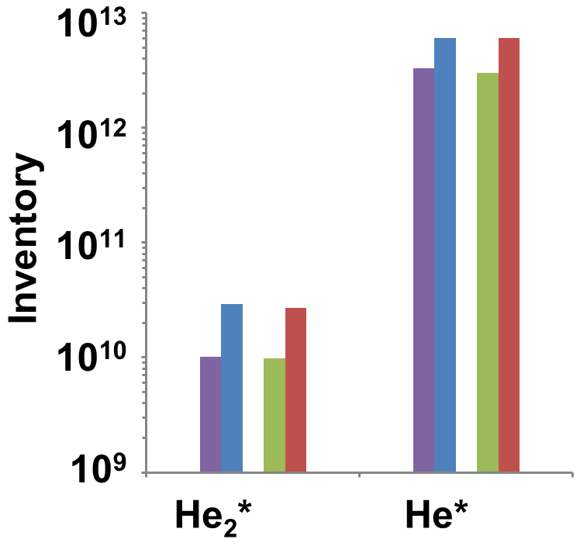
He EXCITED STATE PRODUCTION
Inventory at 25 ns
Inventory: integrated density over computational domain
He*/He₂* higher with ground electrode as n_{e} within tube is higher
He*/He₂* inventory independent of which ring is powered
    Penning ionization of N₂, O₂, H₂O at interface of He plume and air:
    He* + M → He + M⁺ + e
    He₂* + M → He + He + M⁺ + e
University of Michigan
Institute for Plasma Science & Engr.
ISPC 2015

Slide 13
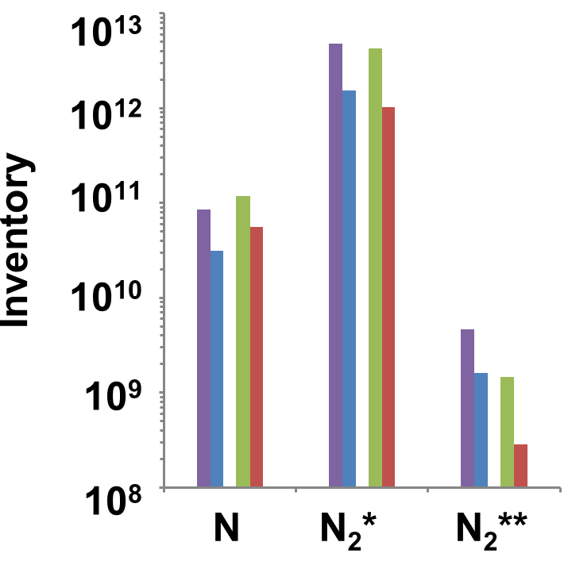
TOTAL RNS PRODUCTION
  Inventory at 25 ns
  Formed by e-impact:
    e + N₂ → N + N + e, (12.3 eV)
    e + N₂ → N₂* + e, (6.2 eV)
    e + N₂ → N₂** + e, (11.0 eV)
  These further react:
    N₂* + O₂→ O + O + N₂
    N₂* + O → NO + N
    N + O₂ → NO + O
    NO + O + M→ NO₂ + M
    N + O⁻ → NO + O + e
  Powering upper ring decreases N₂**, artifact of slower propagation of IW
  RNS decreases by 50-80% with grounded ring.
  Lower T_{e} and n_{e} outside of tube where N₂ diffuses into plume.
University of Michigan
Institute for Plasma Science & Engr.
ISPC 2015

Slide 14
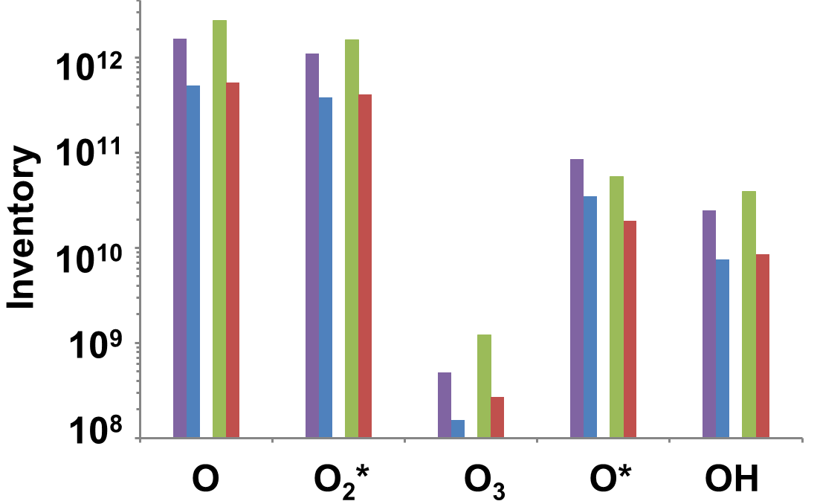
TOTAL ROS PRODUCTION
  Inventory at 25 ns
  Production of ROS:
    e + O₂ → O + O + e
    e + O₂ → O⁻ + O + e
    e + O₂ → O₂* + e
    O + O₂ + M → O₃ + M
    e + O₂ → O* + O + e
    e + H₂O → H + OH + e
  These further react:
  N + O + M → NO + M
  NO + O + M → NO₂ + M
  O₂* + O₂→ O + O₃
  OH + OH + M
  → H₂O₂ + M
  ROS decrease by 65-70% with grounded ring.
  Lower T_{e} and n_{e} outside of the tube where O₂ and H₂O diffuse into plume.
University of Michigan
Institute for Plasma Science & Engr.
ISPC 2015

Slide 15
CONCLUDING REMARKS
Adding a grounded ring electrode downstream from powered electrode increases n_{e} inside tube, decreases n_{e} outside of tube, and decreases T_{e} outside of the tube.
A grounded ring on the thin dielectric tube produces a larger capacitance to ground. This ‘capacitor’ is closer to the powered electrode than the grounded pump.
Current charging this ‘capacitor’ deposits energy only within the tube, resulting in lower energy deposition outside the tube.
The "in tube energy"
Generates more reactive neutrals within the tube: He*/He₂* increase 40-65%
Produces fewer reactive neutrals outside of the tube: RNS decrease 50-80% and ROS decrease 65-70%
University of Michigan
Institute for Plasma Science & Engr.
ISPC 2015

