Slide 1
LOW-PRESSURE INDUCTIVELY COUPLED PULSED MICROPLASMAS FOR VUV PHOTONS PRODUCTION*
Yiting Zhang^{b}, Mark Denningª, Randall S. Urdahlª
and Mark J. Kushner^{b}
ª Agilent Laboratories, Santa Clara, CA USA
(mark.denning@agilent.com, randall_urdahl@agilent.com)
^{b} Department of Electrical and Computer Engineering,
University of Michigan, Ann Arbor, MI USA
(yitingz@umich.edu, mjkush@umich.edu)
The 7th International Workshop on Microplasmas
May 22, 2013 Beijing China
* Work supported by Agilent Laboratories, the Department of Energy Office of Fusion Energy Sciences and the National Science Foundation.

Slide 2
AGENDA
Introduction
VUV emission in low pressure micro-plasma devices
Inductively Coupled Plasmas (ICP)
Description of the model
Photon/Ion flux ratios in ICP mode
ICP Power
Pressure
Aspect ratio
Pulsing
Concluding remarks
University of Michigan
Institute for Plasma Science & Engr.
YZHANG_iwm7_01

Slide 3
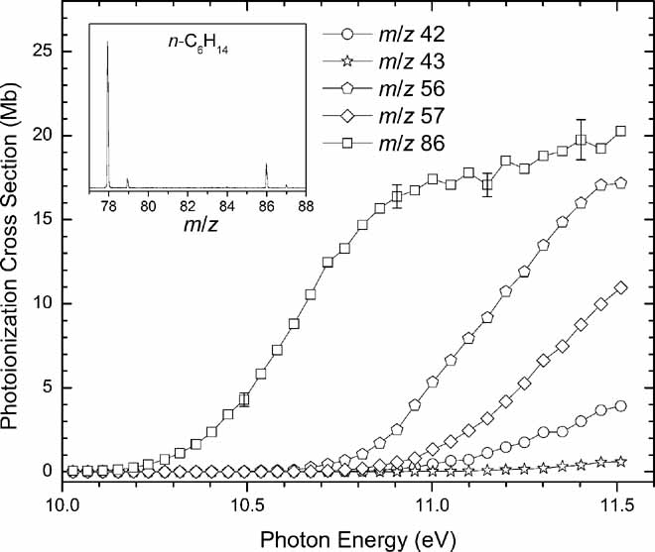
VUV IN LOW PRESSURE MICRO-PLASMA DEVICES
Microplasma discharges are typically operated at high pressure due to pd scaling. However, low pressure operation offers advantages:
Spatially precise surface processing
Treatment of soft materials
Chemical analysis
Resonance
VUV Radiation
Kr
Ar
Low pressure plasmas sustained in rare gases and rare gas mixtures can be efficient sources of VUV emission from resonant optical transitions.
This VUV emission can be used as a selective ionization source in mass spectrometers (MS).
Varying gas mixture produces different VUV spectra.
University of Michigan
Institute for Plasma Science & Engr.
YZHANG_iwm7_03
Notes:
3

Slide 4
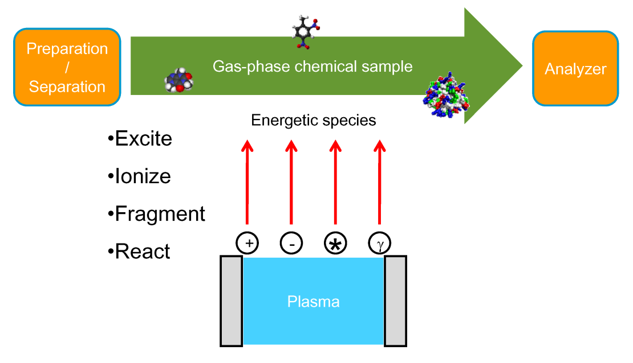
PHOTON/ION FLUX RATIOS IN ICP
The plume from a micro-plasma potentially contains many types of energetic species – ions, photons, electrons, excited states.
To have precise control of ionization of sample and reduce “contamination” of MS, one ideally wants only photons to interact with the sample.
This computational investigation addresses VUV production in ICP microplasma devices.
Controlling the flux of photons vs. ions to the sample using pulsed plasmas will be discussed.
University of Michigan
Institute for Plasma Science & Engr.
YZHANG_iwm7_05
Notes:
4

Slide 5
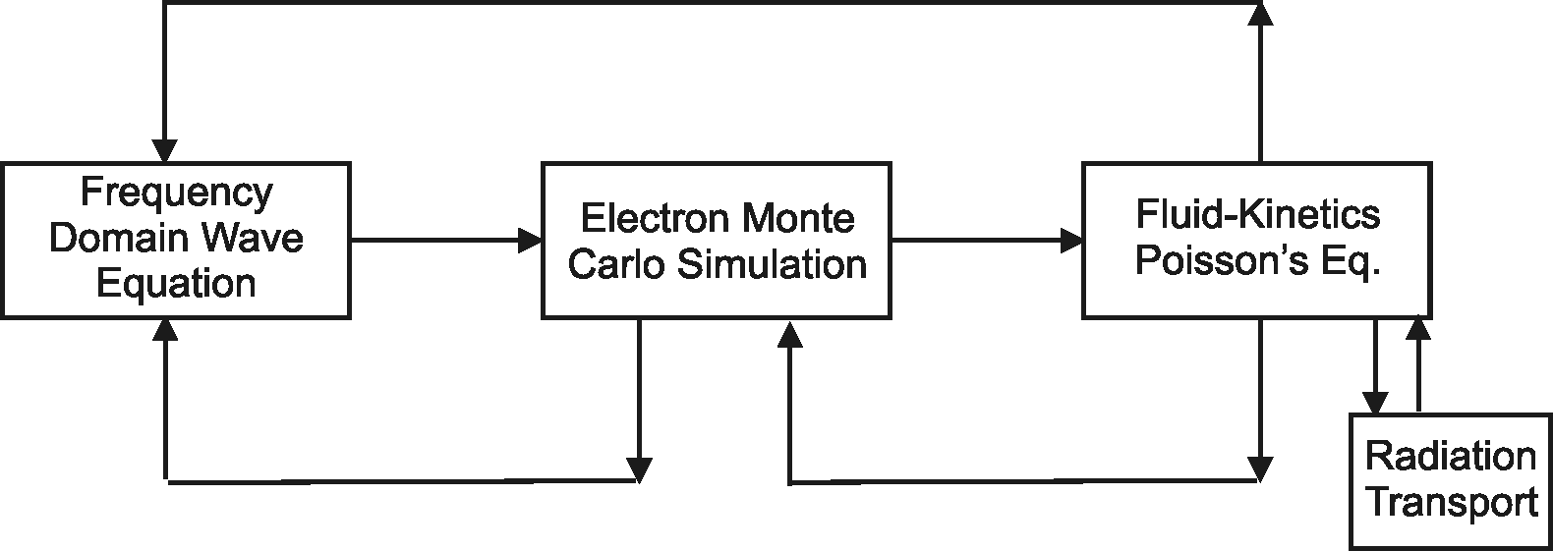
HYBRID PLASMA EQUIPMENT MODEL
The Hybrid Plasma Equipment Model (HPEM) is a modular simulator that combines fluid and kinetic approaches. It resolve multi-physics over multi-scales and is optimized for low pressure.
Radiation transport is addressed using a spectrally resolved Monte Carlo simulation.
University of Michigan
Institute for Plasma Science & Engr.
YZHANG_iwm7_06

Slide 6
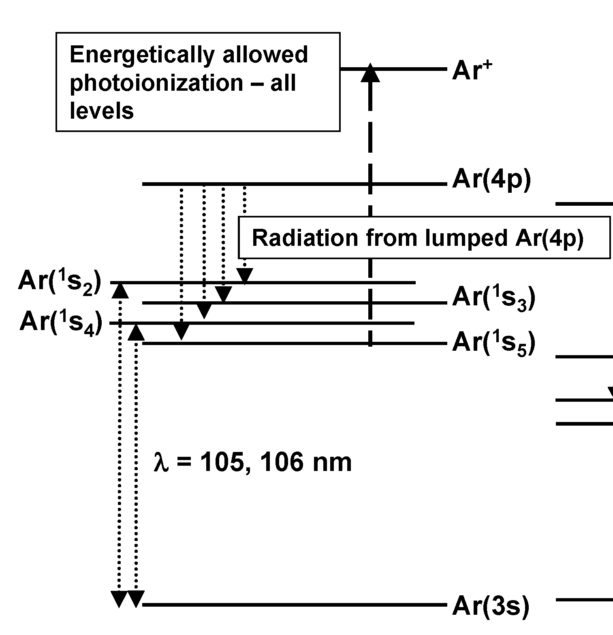
ATOMIC MODEL FOR Ar
Assessment of VUV resonance radiation requires more detailed atomic models.
Argon Atomic model:
Ar, Ar(1s_{2,3,4,5}), Ar(4p), Ar⁺, e,
Ar₂*, Ar₂⁺
Electron impact excitation and super-elastic collisions between all levels.
Atomic collisional mixing of Ar(1s_{2,3,4,5}).
University of Michigan
Institute for Plasma Science & Engr.
YZHANG_iwm7_08

Slide 7
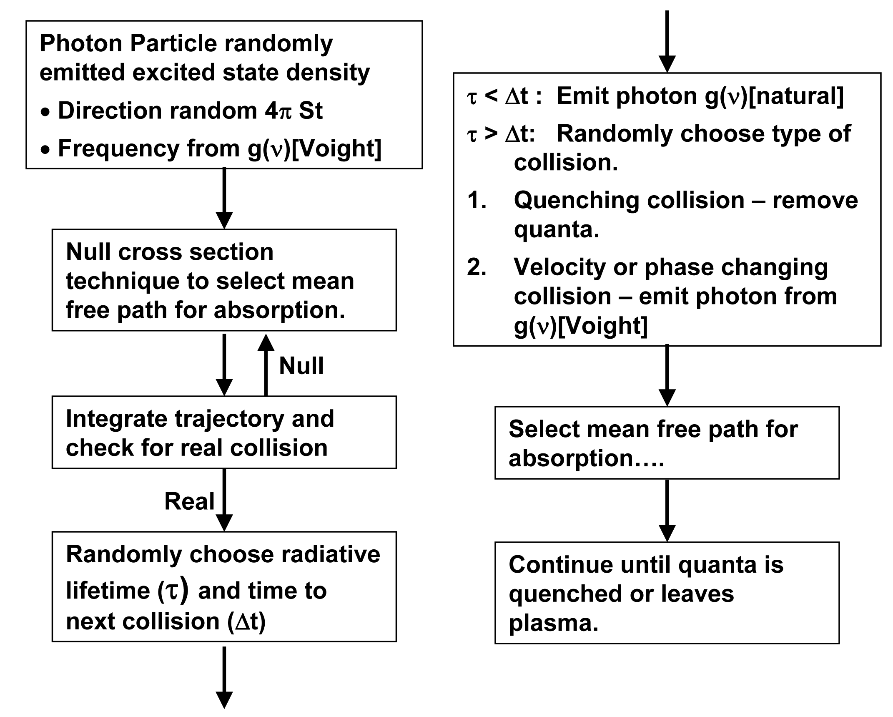
RADIATION TRANSPORT MODEL IN HPEM
Radiation transport is modeled using a Monte Carlo simulation accounting for Partial Frequency Redistribution and radiation trapping.
YZHANG_iwm7_07

Slide 8
PULSED PLASMAS
In the small devices of interest (100s to 1000 μm) cw operation of ICPs is difficult due to large currents required to produce above threshold E/N. Resistive heating of coils would be damaging.
Pulsed plasmas are used to minimize time-averaged coil currents.
A fast rising pulse can “over-shoot” the self sustaining E/N, and produce hot tails to f(ε) that improve efficiency.
P_{max}
Power(t)
Duty Cycle
P_{min}
Time
τ = 1/υ
University of Michigan
Institute for Plasma Science & Engr.
YZHANG_iwm7_04
Notes:
8

Slide 9
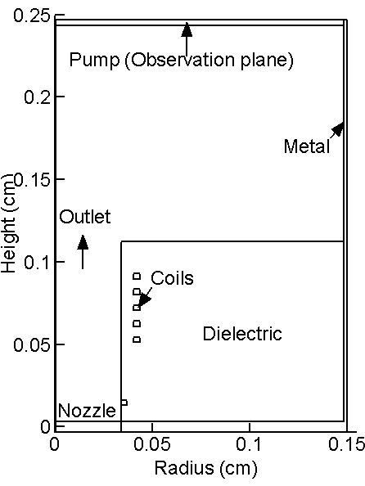
BASE CASE: Ar, 4 TORR, 1 W, 3 sccm
2-D cylindrical symmetric geometry.
Electrical boundary condition applied to outer limit of mesh.
2.5 GHz ICP
Time averaged values shown here.
Specify power – adjust current.
University of Michigan
Institute for Plasma Science & Engr.
YZHANG_iwm7_09
Notes:
9

Slide 10
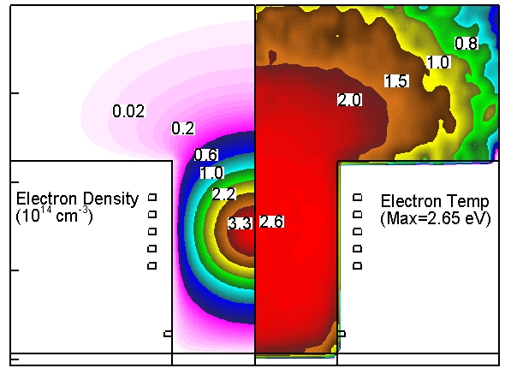
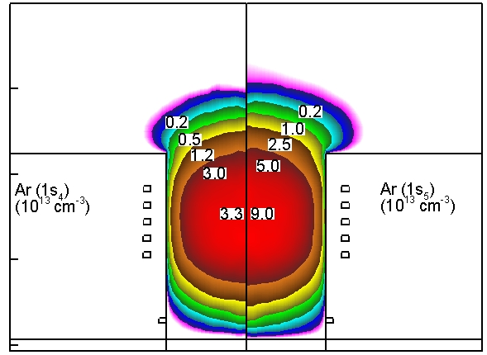
CW PLASMA PROPERTIES
Electron densities exceed 10¹⁴ cm⁻³
Electron temperatures of 2.0 -2.7 eV
The radiating excited state Ar(1s₄) has a trapped lifetime of 16 ns with trapping factor 7.32. It radiates where it is excited by electron impact or by mixing.
Ar(1s₅) is metastable and is quenched by collisions or on walls, and feeds Ar(1s₄) by collisional mixing.
University of Michigan
Institute for Plasma Science & Engr.
Ar, 4 Torr, 1 W, 3 sccm
YZHANG_iwm7_10
Notes:
10

Slide 11
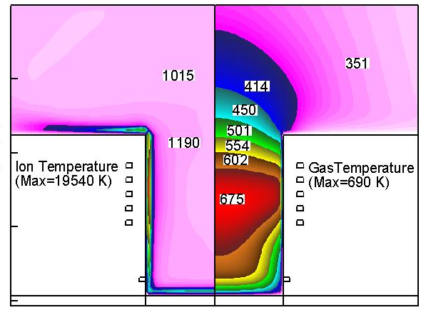
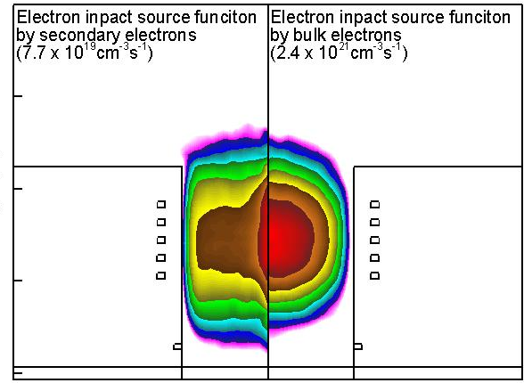
CW PLASMA PROPERTIES
Bulk ion temperatures are a few tenths of eV – a few eV in sheaths.
Gas temperature is highest near coils where rate of ion charge exchange is largest.
Ionization comes from two sources.
Bulk electrons – dominant source
Secondary electrons emitted from surfaces.
University of Michigan
Institute for Plasma Science & Engr.
Ar, 4 Torr, 1 W, 3 sccm
YZHANG_iwm7_11
Notes:
11

Slide 12
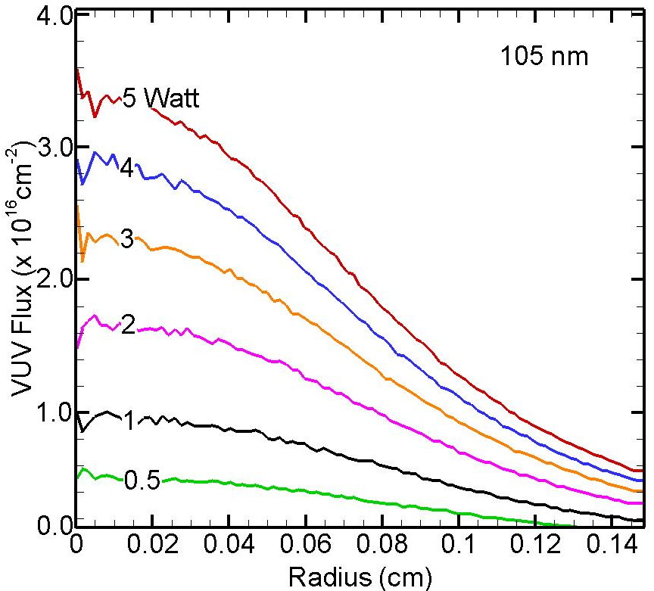
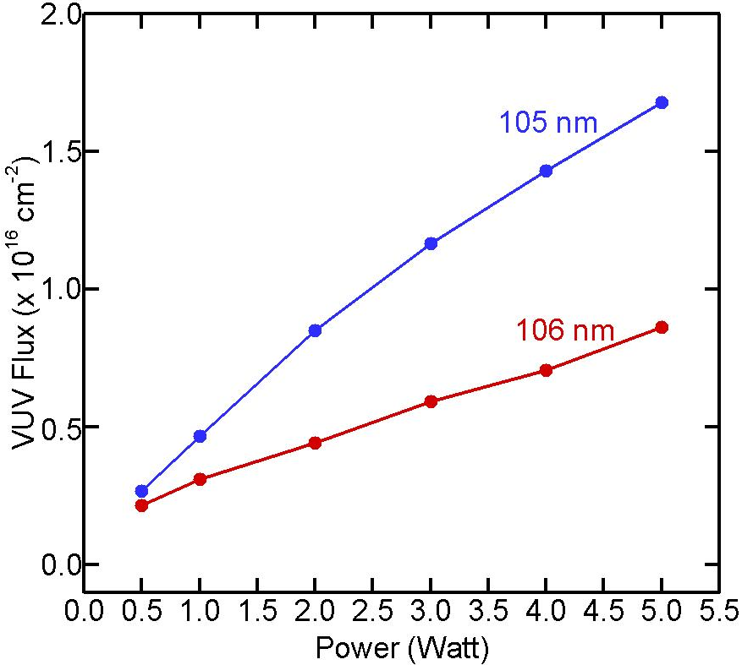
VUV FLUX vs POWER, POSITION
Multistep ionization and electron collision quenching deplete metastable Ar(1s_{5,3}) and so reduces replenishment of radiative Ar(1s_{2,4}).
Saturation (near equilibrium) begins at higher powers.
University of Michigan
Institute for Plasma Science & Engr.
Ar, 4 Torr, 3 sccm, 2.5 GHz
YZHANG_iwm7_12

Slide 13
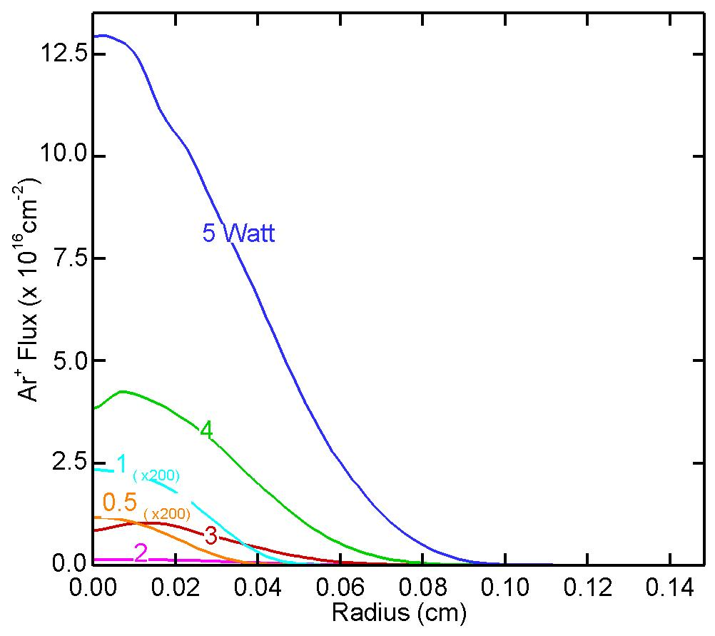
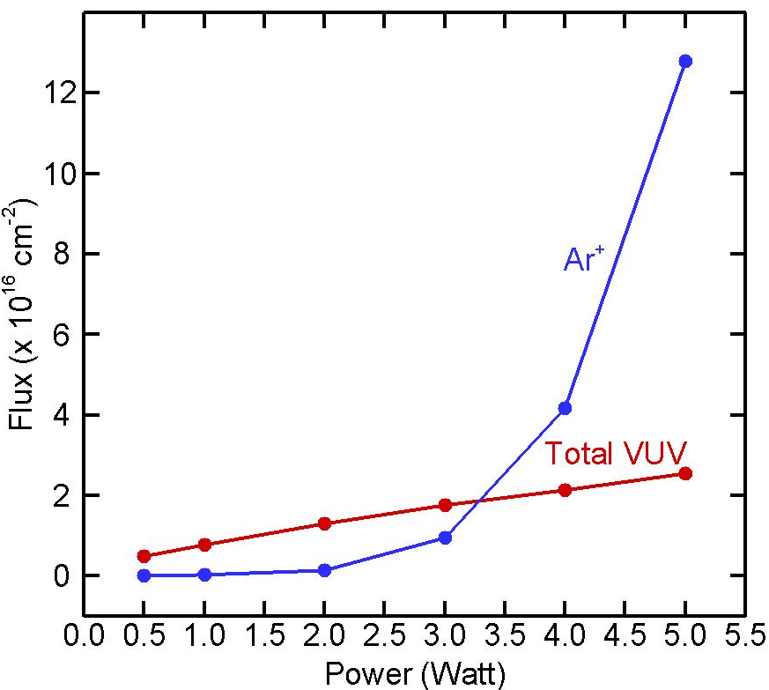
Ar⁺ FLUXES TO COLLECTION PLANE
With the power increase, the ionization rate will significantly increase and argon ion density will largely exceed photon densities. The observation plane will mainly collect argon ion, which obstruct VUV generation.
University of Michigan
Institute for Plasma Science & Engr.
Ar, 4 Torr, 3 sccm, 2.5 GHz
YZHANG_iwm7_13

Slide 14
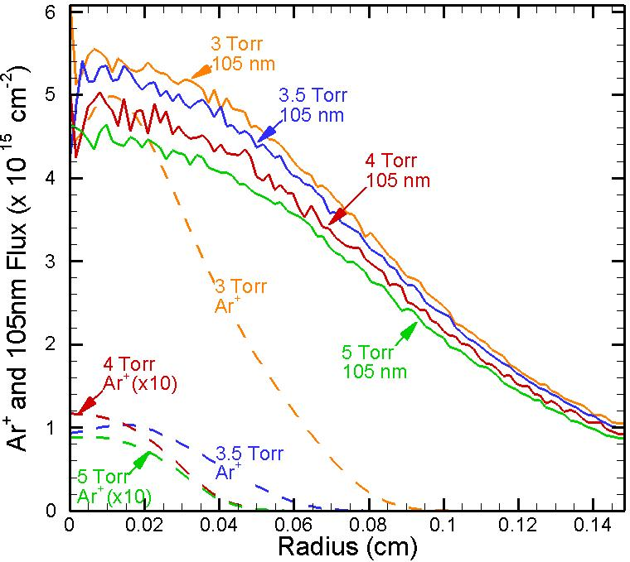
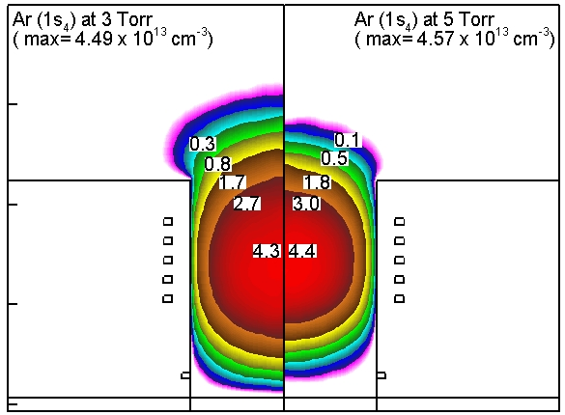
VUV vs. PRESSURE
Varying pressure affects VUV photon emission and ion transport.
The VUV flux is weakly sensitive to pressure (3-5 Torr).
The Ar⁺ flux is sensitive to pressure as pressure exceeds 5 Torr.
VUV to Ar⁺ flux increases significantly with increasing pressure.
Ar, 3 sccm, 2.5 GHz, 1 Watt
University of Michigan
Institute for Plasma Science & Engr.
YZHANG_iwm7_14

Slide 15
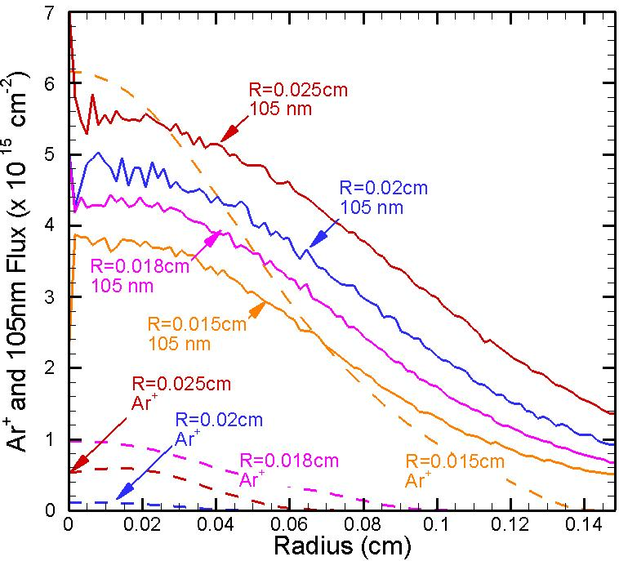
ASPECT RATIO: ICP TUBE DIAMETER
Preliminary system studies were performed on radius of ICP flow tube.
For constant power, smaller radius increases power density which increases electron and Ar* densities while decreasing solid angle.
VUV decreases with smaller radius.
Ar⁺ diffusion losses to smaller diameter tube dominate over increased density – flux to observation plane decreases with smaller radius. VUV/Ar⁺ then increases.
Ar, 4.0 Torr, 3 sccm, 2.5 GHz, 1 Watt
University of Michigan
Institute for Plasma Science & Engr.
YZHANG_iwm7_15

Slide 16
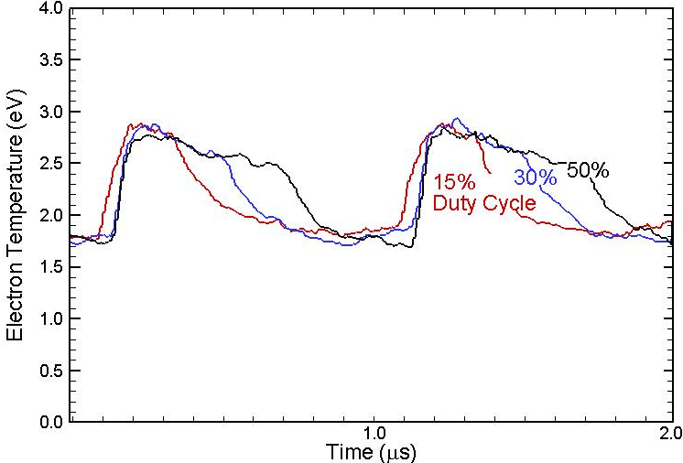
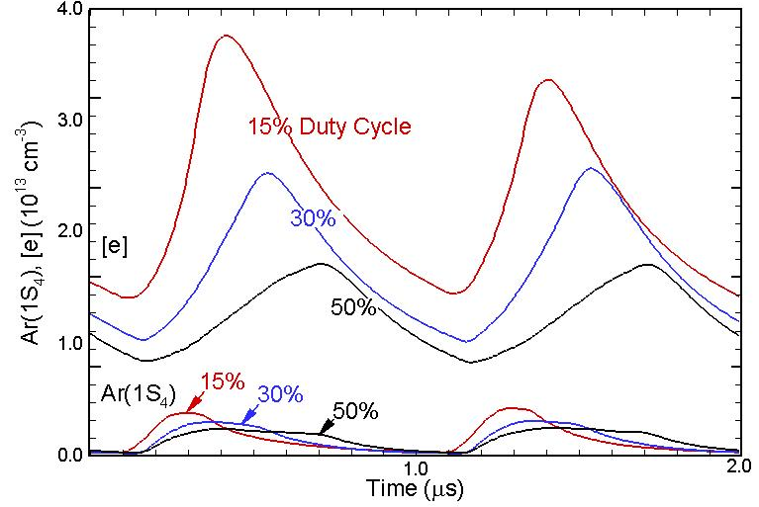
PULSING TO REDUCE AVERAGE COIL CURRENT
reformat the plot with last two cycles
With a continuous wave (cw) excitation, required coil current will likely damage small diameter wires. Damage may be avoided by pulsed operation.
Electrons are heated to higher T_{e} at the leading edge of the power pulse. Overshoot is larger with lower duty cycle.
The peak production of excited states was found larger than with cw excitation.
Ar, 4.0 Torr, 3 sccm, 2.5 GHz, 1 W, PRF = 1MHz
Duty Cycle=fraction power on time during a cycle
University of Michigan
Institute for Plasma Science & Engr.
YZHANG_iwm7_16

Slide 17
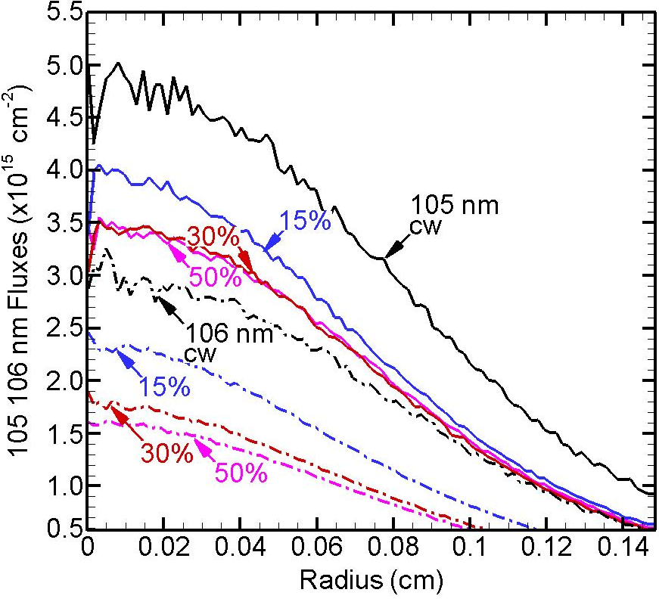
PULSE AVERAGE VUV FLUXES
When averaged over the pulsed period, pulsed operation with low duty cycle produces comparable VUV fluxes to CW.
The initial overshoot in T_{e} produces radiating states more efficiently compensates for the off period.
Ar, 4.0 Torr, 3 sccm, 2.5 GHz,
1 Watt, PRF = 1 MHz
University of Michigan
Institute for Plasma Science & Engr.
YZHANG_iwm7_17

Slide 18
CONCLUDING REMARKS
ICP excitation of microplasmas may be an efficient source of VUV resonant radiation.
The saturation in VUV output with increasing power observed in capacitively coupled devices is less severe in ICP operation.
Pressure and channel radius are both important parameters to optimize VUV output while minimizing “contamination” by ion fluxes.
CW operation will be difficult due to high coil currents – pulse will be required to reduce time averaged current.
The overshoot in T_{e} at leading edge of pulse cycle results in more excitation and an increase the Ar excited states densities. Pulsing may provides a way to optimize the VUV flux while reducing time averaged currents.
University of Michigan
Institute for Plasma Science & Engr.
YZHANG_iwm7_18
Notes:
18

